Slide 1
Fall Protection in Construction
§1926 Subpart M
Presented by:
Notes:
Revised: January 2020
The information in this presentation is provided voluntarily by the N.C. Department of Labor, Education Training and Technical Assistance Bureau as a public service and is made available in good faith. This presentation is designed to assist trainers conducting OSHA outreach training for workers. Since workers are the target audience, this presentation emphasizes hazard identification, avoidance, and control – not standards. No attempt has been made to treat the topic exhaustively. It is essential that trainers tailor their presentations to the needs and understanding of their audience.
The information and advice provided on this Site and on Linked Sites is provided solely on the basis that users will be responsible for making their own assessment of the matters discussed herein and are advised to verify all relevant representations, statements, and information.
This presentation is not a substitute for any of the provisions of the Occupational Safety and Health Act of North Carolina or for any standards issued by the N.C. Department of Labor. Mention of trade names, commercial products, or organizations does not imply endorsement by the N.C. Department of Labor.

Slide 2
Objectives
After this course, students will:
Recognize fall hazards in construction
Understand Subpart M requirements
Be able to apply fall protection standards to construction
work sites
Notes:
This presentation will only cover the key topics for the fall protection standard. The specifics are in the standard itself.
In North Carolina, falls is one of our leading killers each year. In the five year period from 2012 – 2016, the leading cause of death in construction was a result of falls. Therefore, falls is a major component of our Construction Special Emphasis Program (OPN 123T).
As a result of this presentation, I want you to have a better understanding of Subpart M.
Ultimately, I want you to be able to apply the standards to your own site and improve the safety of you and your employees.

Slide 3
Falls = 36% of CY 2012-2016 Construction Fatalities in North Carolina
Notes:
Chart by NCDOL employee Andy Sterlen on 01/08/18 based on data from PSIM.
An analysis of construction fatalities investigated by the North Carolina Occupational Safety and Health Division (NC OSH) from 2012-2016. In North Carolina, over 88% of construction fatalities fall in these four categories: Falls, Struck By, Caught In/Between, Electrocution.
Scheduled construction safety inspections (programmed) are normally comprehensive
inspections covering all areas and conditions on a construction site and all safety hazards
regardless of severity. By focusing the safety inspection and concentrating on the four
areas representing the leading causes of construction fatalities and those serious hazards
that are observed, the CSHO may spend less time on qualified sites and more time on
sites that require more compliance assistance. Contractors on sites having effective
safety and health programs in place may avoid comprehensive OSH inspections.

Slide 4
Subpart M – Fall Protection
1926.500-503
Exception
Covers all fall hazards except specific requirements
found in:
Subpart L – Scaffolds
Subpart R – Steel erection
Subpart S – Tunneling operations
Subpart V – Power transmission and distribution
Subpart X – Stairways and ladders
Subpart CC – Cranes and derricks
13 NCAC 07F .0605 – Communication towers
Notes:
Each of the subparts mentioned here have their particular requirements for fall protection that may vary from Subpart M.

Slide 5
Subpart M – Fall Protection
1926.500(a)(1)
Exception
The provisions of this subpart do not apply when employees are making an inspection, investigation, or assessment of workplace conditions prior to the actual start of construction work or after all construction work has been completed
Notes:
1926.500(a)(1) This subpart sets forth requirements and criteria for fall protection in construction workplaces covered under 29 CFR part 1926. Exception: The provisions of this subpart do not apply when employees are making an inspection, investigation, or assessment of workplace conditions prior to the actual start of construction work or after all construction work has been completed.
There is a letter of interpretation dated March 2, 2010 that may be referenced for further clarification about this exemption.

Slide 6
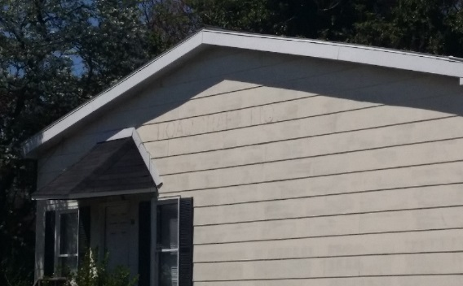
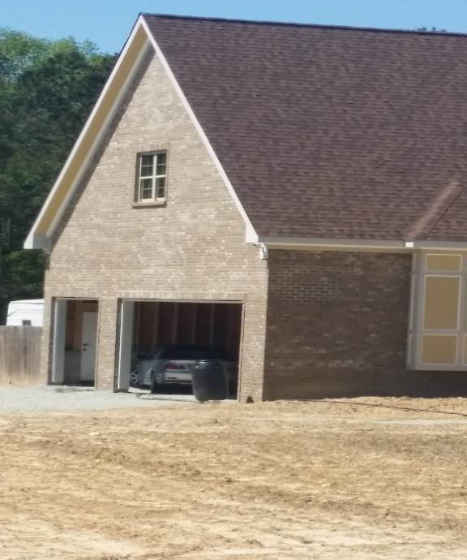
Fall Exposure: Then and now...
1969 Construction
Est. fall exposure
Drip edge = 11 feet
Roof peak = 16 feet
2008 Construction
Est. fall exposure
Drip edge = 23 feet
Roof peak = 38 feet
NCDOL Photo Library
NCDOL Photo Library
Notes:
NCDOL Photo Library: Both Photos Taken By NCDOL Employee Reggie Matthews from a Public Access
Residential construction has evolved over the last 30 years.
A "typical" middle-class home in 1968 was a one story "ranch style" house, normally with a low pitched roof (4:12 to 6:12). (The pitch angle is designated by a ratio of the rise, or vertical measure, in relation to the run, or horizontal measure. For example, a 6:12 pitch roof would rise 6" up for every foot that ran out horizontally.) The 1968 home was also normally built on fairly flat land, whenever available.
Today, we see a different "typical home" being built for the same middle-class family. The house is normally either a story and a half or two story. In addition, homes are being built on less desirable lots with slopes, which adds height to at least one side of the home. This is coupled with the roof pitch being raised to 10:12, 12:12, and even 14:12.
Today, with the additional height from the added second story, a sloped yard, and a higher pitched roof, a fall potential of 27 feet to the drip edge of today's home, and 42 feet to the roof peak is nothing unusual. This would be in comparison to a 1968 home having a fall exposure height which would have been estimated at 12 feet from the drip edge of the roof, and 17 feet to the peak.
The sample houses shown have an estimated respective fall exposure of 11' from the drip edge and 16' from the peak, for the 1968 construction, and 23' from the drip edge and 38' from the peak for the 1998 home.
[Calculation Notes: 1968 home - based on a 30' wide wall, 4:12 pitch roof, 8' wall height, 3' crawl space, and a 1' base band. 1998 home - based on 30' wide wall, 12:12 pitch roof, 9' first floor wall, 8' second floor wall, 8' crawl space at lowest point of slope, and a 1' base band for each floor.]
Rolling or slipping off of the roof is one of the most common of injuries reported as a result of "falling from a different elevation" in residential construction [according to Builders Mutual Insurance Co. claims information]. Effectively, the fall height from the "drip edge" (the lowest point of the roof) has potentially more than doubled, while attempts at preventing falls have remained, for the most part, as they were 30 years ago.
A lack of worker education and limited fall protection equipment, compounded by inadequate guidelines, rules, and enforcement by OSHA, has allowed this ever growing exposure to residential construction workers to exist.

Slide 7
Fall Protection Requirements
Steel Erection
15′
Scaffolds
10′
Construction
6′
General Industry
4′
Notes:
Graphic by NCDOL Employee Tom Wilder
Fall protection in Construction and General Industry is varied and is triggered at different heights depending on the activity.

Slide 8
Duty to Have Fall Protection 1926.501(a)
Employer required to provide fall protection systems
Employer must determine if the walking/working surfaces on which its employees are to work have the strength and structural integrity to support employees safely
Notes:
1926.501(a)
"General."
1926.501(a)(1)
This section sets forth requirements for employers to provide fall protection systems. All fall protection required by this section shall conform to the criteria set forth in 1926.502 of this subpart.
1926.501(a)(2)
The employer shall determine if the walking/working surfaces on which its employees are to work have the strength and structural integrity to support employees safely. Employees shall be allowed to work on those surfaces only when the surfaces have the requisite strength and structural integrity.
NOTE: The standard reference number is at the top right hand corner of many slides in this presentation. This is a quick reference for you to go directly to that number in the construction industry standards book.
As we saw in our previous slide, the duty to have fall protection in construction begins at the 6 foot level.
Walking/working surfaces must be inspected before work begins and they must be strong enough to support the weight of the employees and equipment that they are using.

Slide 9
Fall Protection Required 1926.501(b)(1)-(15)
Unprotected sides, edges
Leading edges
Hoist areas
Holes
Formwork, reinforcing steel
Ramps, runways
Excavations
Dangerous equipment
Overhand bricklaying
Low-slope roofs
Steep roofs
Pre-cast concrete erection
Residential construction
Wall openings
Other walking and working surfaces
Notes:
These are specific construction activities and areas where Subpart M fall protection requirements apply. We will concentrate on many of these areas in today’s class.
REMEMBER: Construction activities like scaffolding, stairways and steel erection are not included in this list because there are specific Subparts in the 1926 construction standard that address those areas.
*Note to instructor (not necessary to share with students): We do not currently have a slide for the pre-cast concrete erection, because we do not have a photograph depicting these activities. We will update the presentation when a photo becomes available.

Slide 10
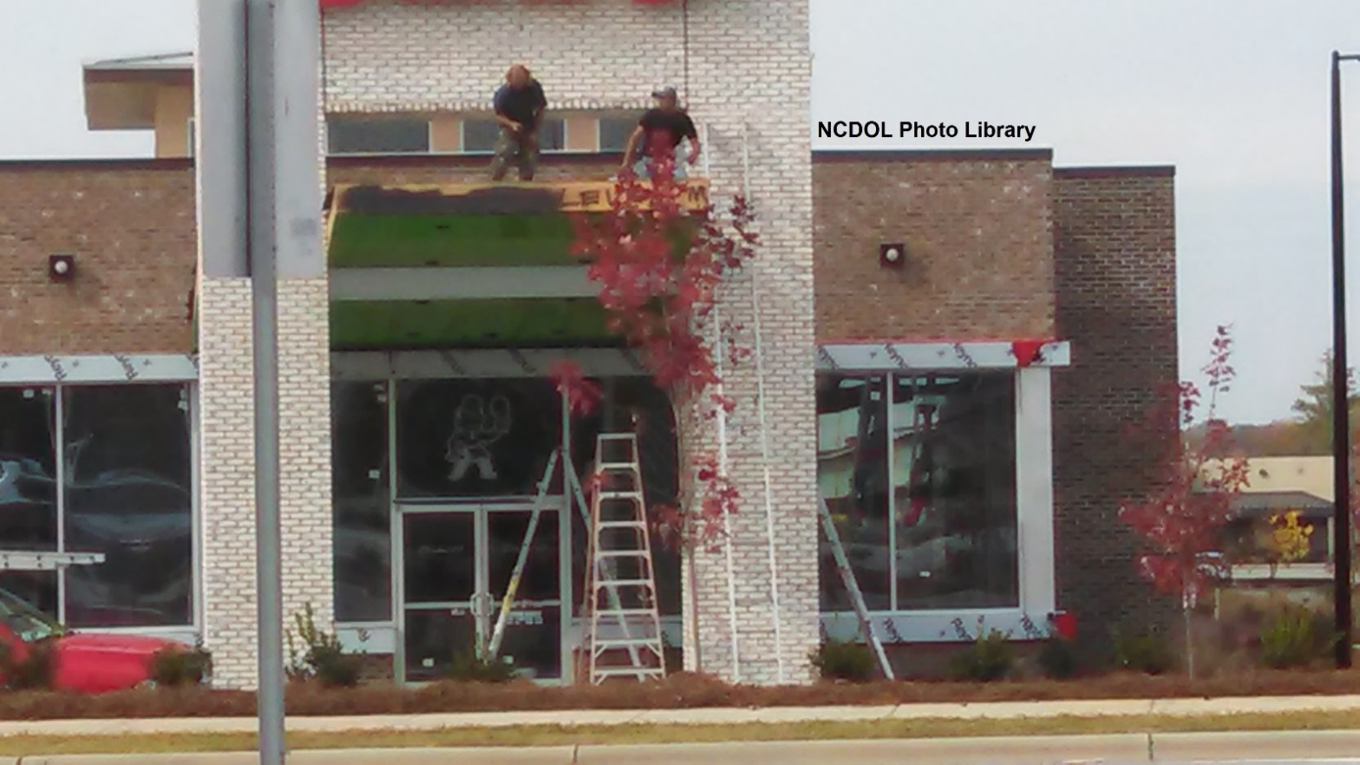
Fall Protection Required
1926.501(b)(1)
Unprotected sides and edges
Notes:
NCDOL Photo Library: Photo taken by NCDOL Employee Kimberly Bostic, Public Access
1926.500(b) Unprotected sides and edges means any side or edge (except at entrances to points of access) of a walking/working surface, e.g., floor, roof, ramp, or runway where there is no wall or guardrail system at least 39 inches (1.0 m) high.
photo: Example of unprotected edge where fall protection would be required

Slide 11
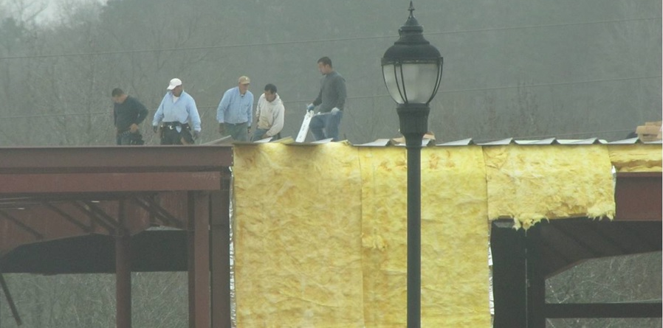
Fall Protection Required
1926.501(b)(2)
Leading edges
NCDOL Photo Library
Notes:
NCDOL Photo Library: Photo taken by NCDOL Employee Robert O’Neal, Public Access
1926.500(b) Leading edges means the edge of a floor, roof, or formwork for a floor or other walking/working surface (such as the deck) which changes location as additional floor, roof, decking, or formwork sections are placed, formed, or constructed. A leading edge is considered to be an "unprotected side and edge" during periods when it is not actively and continuously under construction.

Slide 12
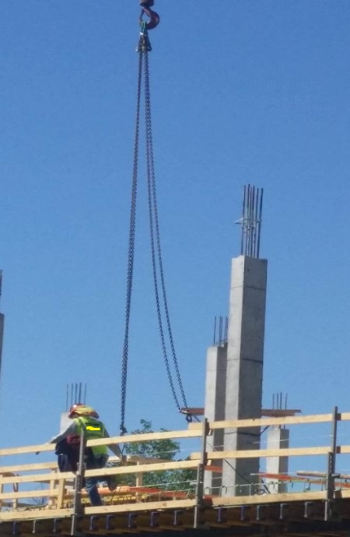
Fall Protection Required
1926.501(b)(3)
Hoist areas
NCDOL Photo Library
Notes:
NCDOL Photo Library: Photo Taken By NCDOL Employee Reggie Matthews from a Public Access
1926.501(b)(3) Each employee in a hoist area shall be protected from falling 6 feet (1.8 meters) or more to lower levels by guardrail systems or personal fall arrest systems.
If guardrails are removed and an employee must lean through the access opening, an employee shall be protected from fall hazards by a personal fall arrest systems

Slide 13
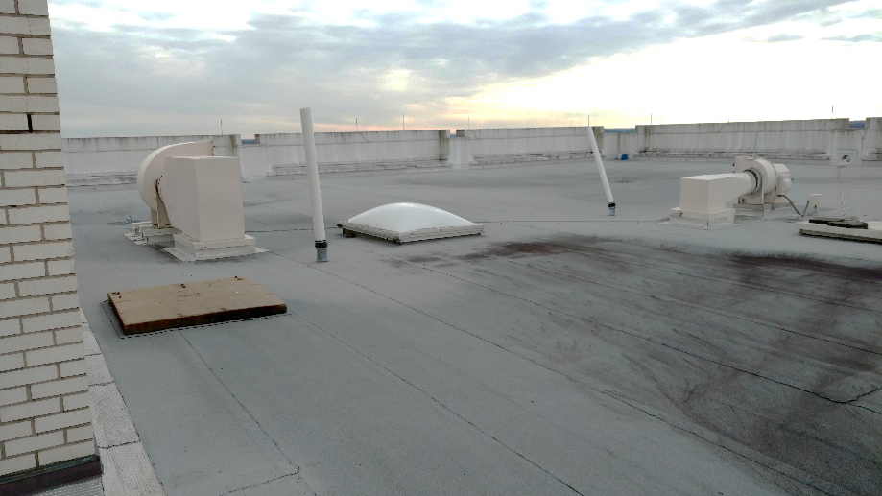
Fall Protection Required
1926.501(b)(4)
Holes
More than 6 feet above lower level
Includes skylights
NCDOL Photo Library
NCDOL Photo Library
Notes:
NCDOL Photo Library: Photos taken by NCDOL Employee Robert O’Neal,– Barnhill Site Building – written approval

Slide 14
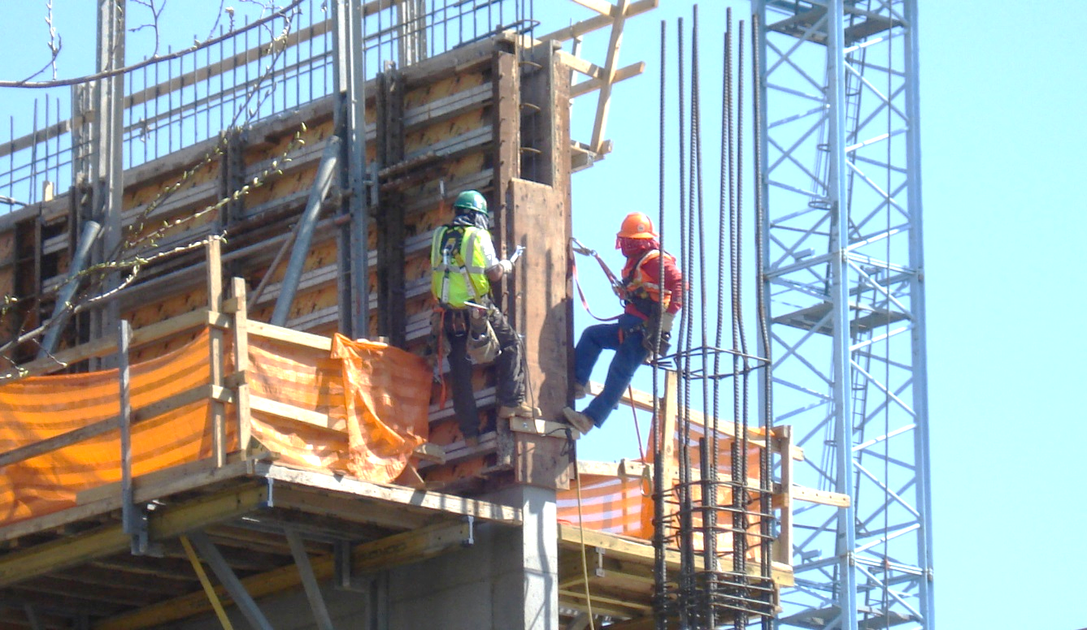
Fall Protection Required
1926.501(b)(5)
Formwork and reinforcing steel
NCDOL Photo Library
Notes:
NCDOL Library: Photo taken by NCDOL Employee Robert O’Neal, Public Access
Formwork in construction where fall protection would be required

Slide 15
Fall Protection Required
1926.501(b)(6)
Ramps, runways, other walkways
NCDOL Photo Library
Notes:
NCDOL Photo Library: Photo Taken By NCDOL Employee Reggie Matthews from a Public Access
1926.501(b)(6) Ramps, runways, and other walkways: Each employee on ramps, runways, and other walkways shall be protected from falling 6 feet (1.8 meters) or more to lower levels by guardrail systems.

Slide 16
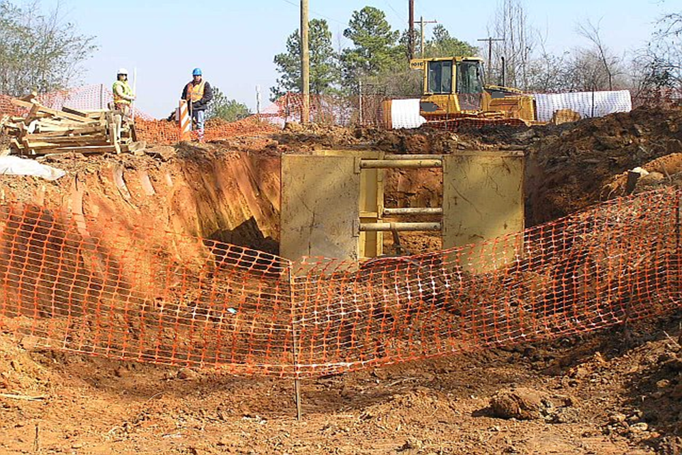
Fall Protection Required
1926.501(b)(7)
Excavations
NCDOL Photo Library
Notes:
Photo taken by NCDOL Employee Robert O’Neal- Public Access
THESE ARE EXAMPLES OF WHERE FALL PROTECTION WOULD BE REQUIRED:
Each employee at the edge of an excavation 6 feet (1.8 m) or more in depth shall be protected from falling by guardrail systems, fences, or barricades *when the excavations are not readily seen because of plant growth or other visual barrier (*This picture does not accurately depict the standard requirement, however it may be used for discussion purposes. You can point out to the students that this picture depicts a situation where fall protection is not necessarily required under 1926.501).
For more details on excavations you may point students to 1926 Subpart P

Slide 17
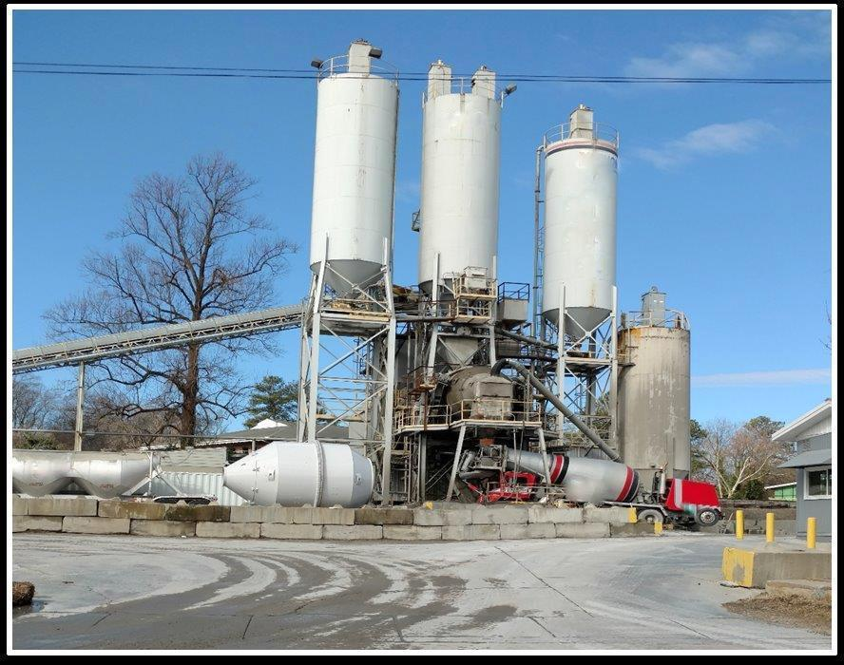
Fall Protection Required
1926.501(b)(8)
Dangerous equipment
NCDOL Photo Library
Notes:
NCDOL Library: Photo Taken by NCDOL Employee Robert O’Neal Public Access
1926.501(b)(8)(i) Dangerous equipment: Each employee less than 6 feet (1.8 m) above dangerous equipment shall be protected from falling into or onto the dangerous equipment by guardrail systems or by equipment guards.
1926.501(b)(8 )(ii) Dangerous equipment: Each employee 6 feet (1.8 meters) or more above dangerous equipment shall be protected from fall hazards by guardrail systems, personal fall arrest systems, or safety nets.

Slide 18
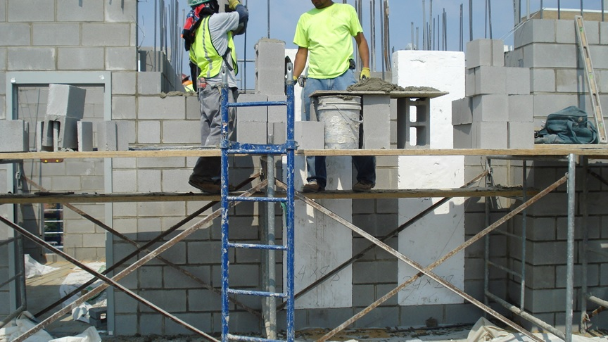
Fall Protection Required
1926.501(b)(9)
Overhand bricklaying
NCDOL Photo Library
Notes:
NCDOL Library: Photo Taken by NCDOL Employee Robert O’Neal, Public Access
1926.501(b)(9)(i) Overhand bricklaying and related work: Except as otherwise provided in paragraph (b) of this section, each employee performing overhand bricklaying and related work 6 feet (1.8 m) or more above lower levels, shall be protected from falling by guardrail systems, safety net systems, personal fall arrest systems, or shall work in a controlled access zone.
1926.501(b)(9)(ii) Overhand bricklaying and related work: Each employee reaching more than 10 inches (25 cm) below the level of the walking/working surface on which they are working, shall be protected from falling by a guardrail system, safety net system, or personal fall arrest system.
*Note: Bricklaying operations performed on scaffolds are regulated by subpart L - Scaffolds of this part (This picture does not accurately depict what would be covered in 1926.501, however it may be used for discussion purposes and to show the activity of overhand bricklaying).

Slide 19
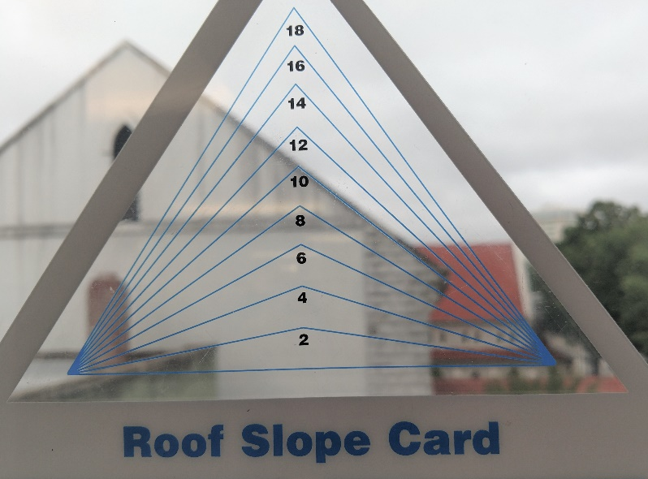
Fall Protection Required
1926.501(b)(10)-(11)
Low-slope roof
< 4/12 pitch
Steep roof
> 4/12 pitch
NCDOL Photo Library
NCDOL Photo Library
Notes:
NCDOL Photo Library: Top Photo Taken By NCDOL Employee Robert O’Neal, Public Access – Identifies a low slope roof of a commercial building.
NCDOL Photo Library: Bottom Photo Taken By NCDOL Employee Robert O’Neal, Public Access – Identifies a steep roof on a church. Note: A roof slope card can assist you at measuring/determining the roof angle from the ground.
Fall protection would be required on either one of these two roofs “low-sloped or steep roofs”. If you work on roofs and can fall more than 6 feet, you must be protected.
Commercial buildings and homes have roofs with slopes ranging from no slope or flat to very steep slopes. Roof pitch is expressed as rise over a 12-inch run, for example 4/12.
1926.500(b) Steep roof means a roof having a slope greater than 4 in 12 (vertical to horizontal).
1926.500(b) low-slope roof means a roof having a slope less than or equal to 4 in 12 (vertical to horizontal).

Slide 20
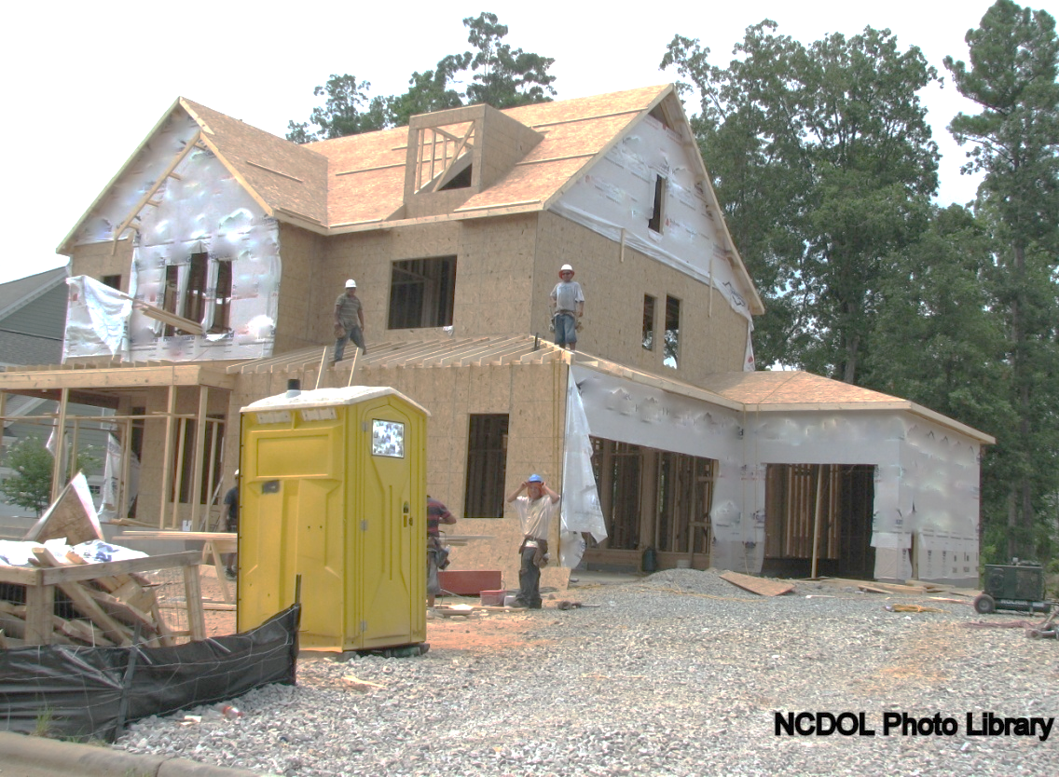
Fall Protection Required
1926.501(b)(13)
Residential construction
STD 03-11-002 for citation guidance
Notes:
NCDOL Photo Library: Closed Case# 314870627 - See STD 03-11-002 for Compliance Guidance for Residential Construction
The term “residential construction” is interpreted as covering construction work that satisfies the following two elements:
The end-use of the structure being built must be as a home, i.e., a dwelling; and
The structure being built must be constructed using traditional wood frame construction materials and methods. The limited use of structural steel in a predominantly wood-framed home, such as a steel I-beam to help support wood framing, does not disqualify a structure from being considered residential construction.
Remember, OSHA has suggest that, at a minimum, fall restraint systems have the capacity to withstand at least three thousand (3,000) pounds of force or twice the maximum expected force that is needed to restrain the person from exposure to the fall hazard in “Residential Construction”. In determining this force, consideration should be given to site-specific factors such as the force generated by a person walking, leaning, or sliding down the work surface.

Slide 21
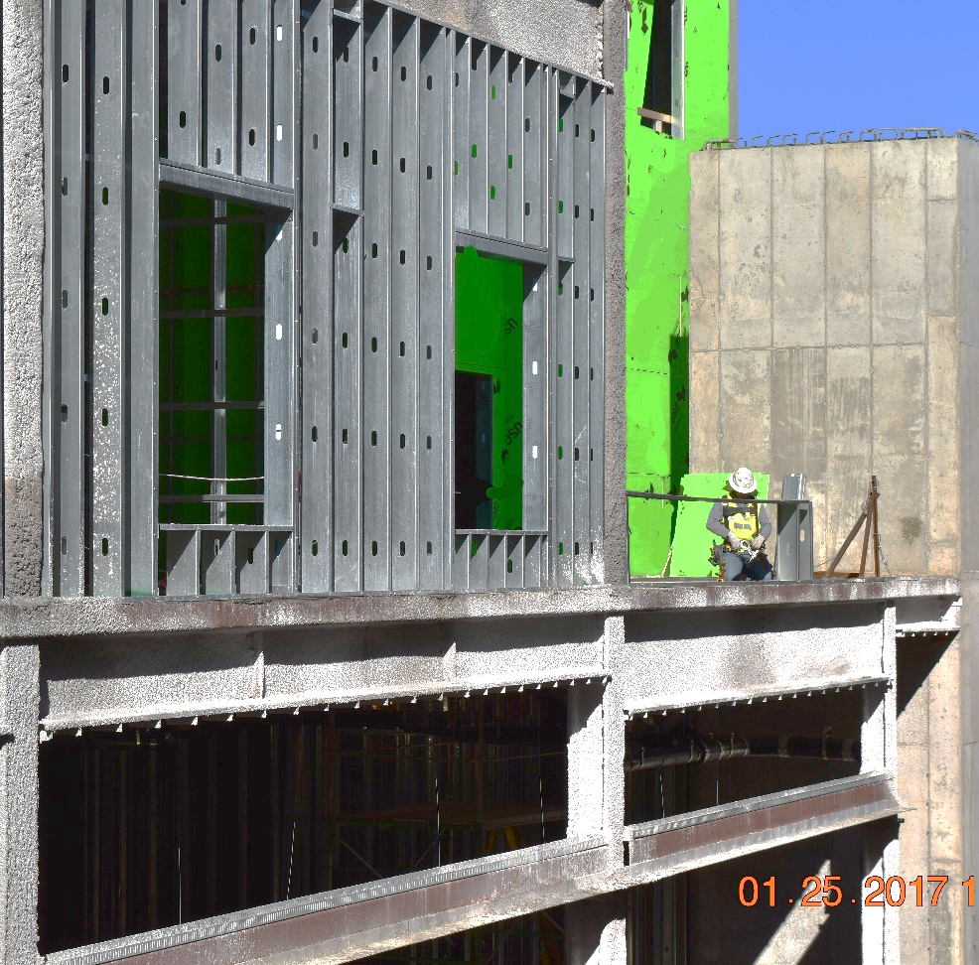
Fall Protection Required
1926.501(b)(14)
Wall openings
Notes:
NCDOL Photo Library: Photo Taken By NCDOL Employee Robert O’Neal – Public Access, 1/25/2017 Photo identifies a wall opening that’s not protected with a guardrail. These is one example of where fall protection would be required!
"Wall openings." Each employee working on, at, above, or near wall openings (including those with chutes attached) where the outside bottom edge of the wall opening is 6 feet (1.8 m) or more above lower levels and the inside bottom edge of the wall opening is less than 39 inches (1.0 m) above the walking/working surface, shall be protected from falling by the use of a guardrail system, a safety net system, or a personal fall arrest system.
1926.500(b) Opening means a gap or void 30 inches (76 cm) or more high and 18 inches (48 cm) or more wide, in a wall or partition, through which employees can fall to a lower level.)

Slide 22
Falling Object
1926.501(c)
Each exposed employee must wear a hard hat
Employer must take steps to prevent employees from being hit by falling objects
Erect toe boards, screens, or guardrail systems
Erect a canopy structure
Barricade the area
Notes:
If there’s a possibility of an object to fall on you, then you must wear a hardhat.
STEPS THAT MUST BE TAKEN to prevent employees from being hit by falling objects:
1. Erect toeboards, screens, or guardrail systems to prevent objects from falling from higher levels (guardrails will be discussed later on in this presentation)
2. Erect a canopy structure and keep potential falling objects far enough from the edge of the higher level
3. Barricade the area to which objects could fall, prohibit employees from entering the barricaded area, and keep objects that may fall far enough away from the edge of a higher level

Slide 23
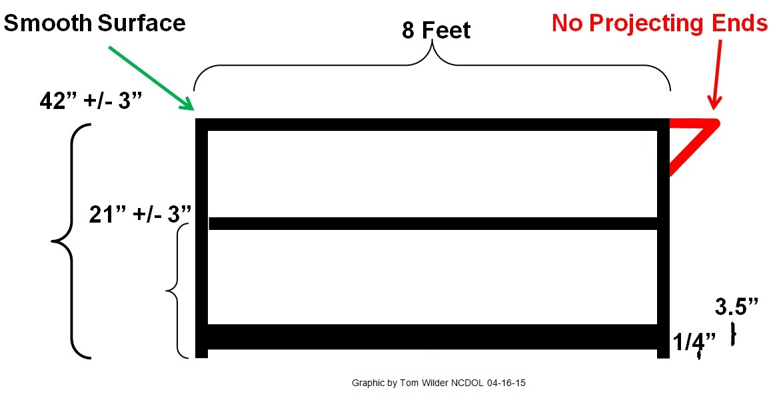
Protection from Falling Objects
1926.502(j)
Toeboards
When used as falling object protection, must be erected along the edge of the overhead walking/working surface
Withstand force of at least 50 pounds
Toeboards must be a minimum of 3½ inches in vertical height
NCDOL Photo Library
Notes:
NCDOL Photo Library: Graphics created by NCDOL Tom Wilder, former employee 4/16/15
1926.502 (j) Toe Boards (Although not technically part of the guard rail system, they are often integrated into the guard rail system): It is a low protective barrier that will prevent the fall of materials and equipment to lower levels and provide protection to personnel from falling objects.
Toeboards, when used as falling object protection, shall be erected along the edge of the overhead walking/working surface for a distance sufficient to protect employees below.
Toeboards shall be capable of withstanding, without failure, a force of at least 50 pounds (222 N) applied in any downward or outward direction at any point along the toeboard.
Toeboards shall be a minimum of 3 1/2 inches (9 cm) in vertical height from their top edge to the level of the walking/working surface. They shall have not more than 1/4 inch (0.6 cm) clearance above the walking/working surface. They shall be solid or have openings not over 1 inch (2.5 cm) in greatest dimension.
Where tools, equipment, or materials are piled higher than the top edge of a toeboard, paneling or screening shall be erected from the walking/working surface or toeboard to the top of a guardrail system's top rail or midrail, for a distance sufficient to protect employees below.
Guardrail systems, when used as falling object protection, shall have all openings small enough to prevent passage of potential falling objects.

Slide 24
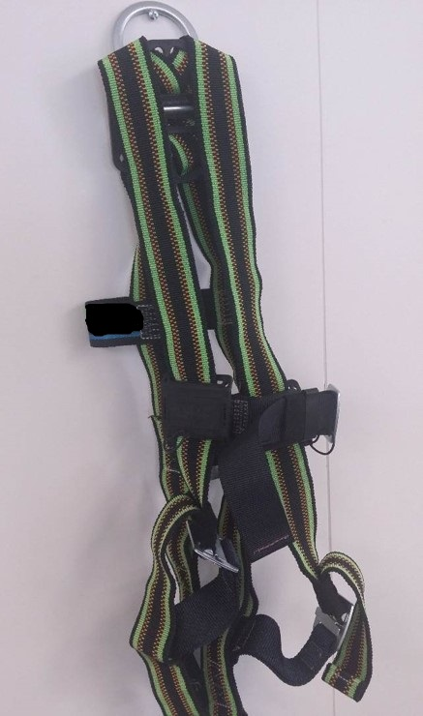
Methods of Fall Protection
1926.502(a)(1)
Conventional methods
Safety nets
Guardrails
Personal fall arrest systems
NCDOL Photo Library
Notes:
NCDOL Photo Library: Photo Taken By NCDOL Employee Reggie Matthews in office
There are a number of fall protection methods that can be used. The standards give employers a choice as to what fall protection method they would like to use, depending on the activity being done, the work site and situation.
Conventional methods of fall protection (you will find these used the most frequently): Guardrails, safety nets, and personal fall arrest systems

Slide 25
Guardrail System
1926.502(b)
NCDOL Photo Library
Notes:
NCDOL Photo Library: Graphic created by Tom Wilder 4/16/15
More information on GUARDRAILS: CAN ALSO REFER TO 1926 SUBPART M APPENDIX B – GUARDRAIL SYSTEMS – NON- MANDATORY GUIDELINES FOR COMPLYING WITH 1926.502(b)
**Explain that a guardrail has support posts, a top rail, and a midrail.
1) 8 foot centers between posts. (specification is outlined in Subpart M Appendix B – non-mandatory guidelines-be sure to point out that this is a non-mandatory requirement)
2) 42” toprail height. 42” is above most people’s center of gravity, so a person falling against the rail will not flip over it.
3) “Halfway” requirement for midrail. The midrail prevents a person from slipping under toprail.
4) Smooth surface requirement for top rail – no projecting ends.
5) Toeboards are required by 1926.502(j)(1). Toeboards are not fall protection per se but meant to prevent items from being knocked off platform onto people’s heads or into machinery. Note 3.5” toeboard height requirement and ¼” space limitation beneath toeboard. ¼” limitation allows for cleaning but should not allow small items to pass through. Toeboards shall withstand a force of at least 50 pounds.
6) Note 200 lb support requirement. Top rails of guardrail system must resist 200 lbs applied in any outward or downward direction. The support requirement is 150 lb for midrails.
Note: Toe boards are not part of a guardrail system for fall protection

Slide 26
Safety Nets
1926.502(c)
Used for:
Bridges
Demolition of multi-story buildings
Rarely used in residential construction
Notes:
SAFETY NETS: Typically used as protection for those who work 25 feet or more above lower levels on bridges and at commercial building construction sites. Safety net systems are rarely used for roofing work, like in residential construction.
USE OF SAFETY NETS:
- Place as close as practicable under the walking/working surface but no more than 30’ below such level.
- When used on bridges, the fall area to net shall be unobstructed
- Shall install with sufficient clearance to surface or objects below
- Drop test required – it is waived if assembled in accordance with specifications
- Defective nets shall not be used
- Make weekly and after impact inspections
- Removal of objects daily or before next shift
- No greater than 6” openings on any side
- Border ropes 5,000# breaking strength
- Connections not more than 6” apart

Slide 27
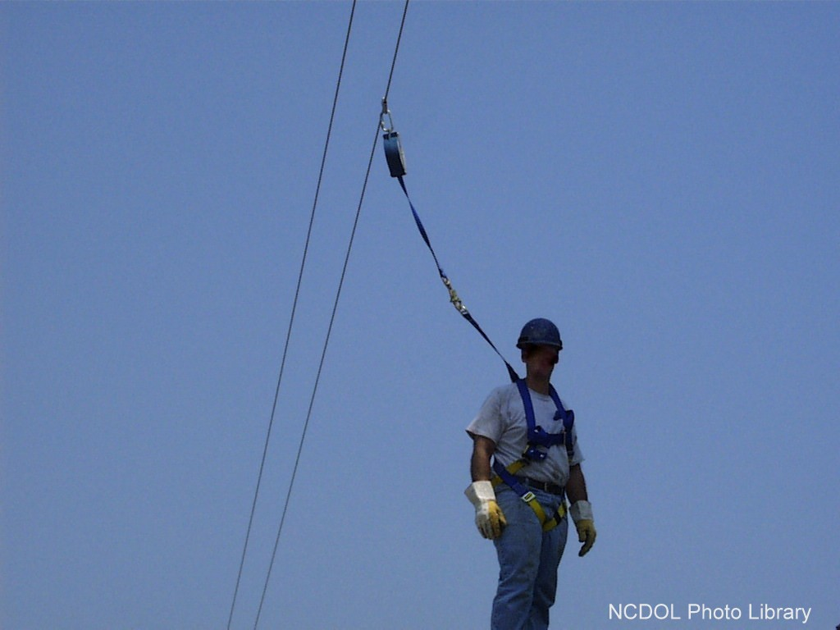
Personal Fall Arrest System (PFAS)
NCDOL Photo Library
Notes:
NCDOL Photo Library: USDOL: OSHA Region 4 Photo Archive CD V1.0 2/2003 (NCDOL has received written approval)
Simply tying off does not necessarily eliminate the hazard of a fall.
Poor planning, improper equipment, and lack of coordination and communication can create hazards as well.
Is there any hazard in this image? Is there proper coordination between workers, materials.

Slide 28
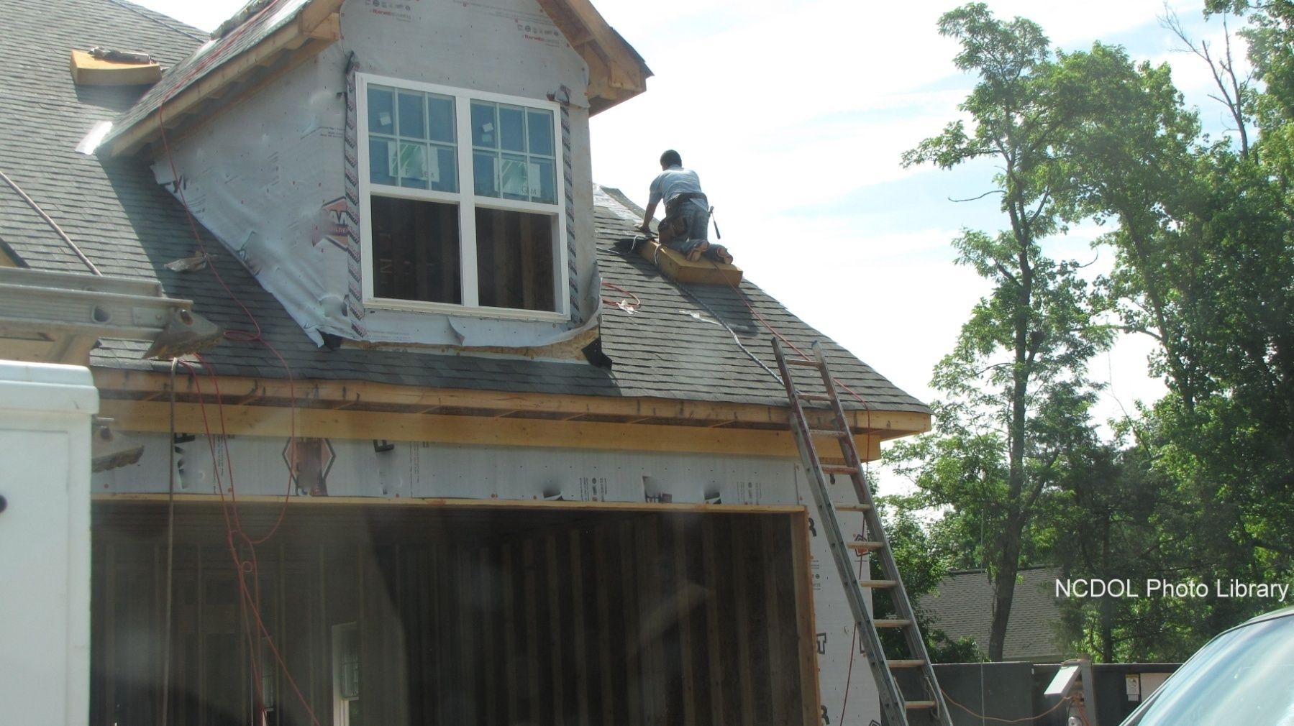
Personal Fall Arrest System
Is this correct?
Notes:
NCDOL Photo Library: Closed Case# 316849306
No. Note ladder issues and lack of fall protection.

Slide 29
Personal Fall Arrest System
1926.502(d)
D-Rings, snaphooks, lanyards, lifelines, anchorages rated @ 5,000 pounds
No free fall more than 6 feet; nor contact any lower level; 3.5 feet maximum deceleration
Provide for prompt rescue
Inspect prior to each use
Notes:
CONNECTORS: D-Rings and snaphooks, lanyards and vertical lifelines: minimum tensile (breaking) strength of 5,000 pounds per employee attached – note the safety factor built into this number
Anchorages: used for attachment of personal fall arrest equipment – shall be independent of any anchorage being used to suspend platforms and capable of supporting at least 5,000 pounds per employee attached OR shall be designed, installed and used to sustain 2 times the intended impact load as determined by a qualified person
3.5’ max deceleration - distance an employee travels before coming to a complete stop (distance that the lanyard goes as it opens—with shock absorbing feature). Personal fall arrest systems, when stopping a fall, shall: 1926.502(d)(16)
limit maximum arresting force on an employee to 900 pounds (4 kN) when used with a body belt; limit maximum arresting force on an employee to 1,800 pounds (8 kN) when used with a body harness; be rigged such that an employee can neither free fall more than 6 feet (1.8 m), nor contact any lower level; bring an employee to a complete stop and limit maximum deceleration distance an employee travels to 3.5 feet (1.07 m); and, have sufficient strength to withstand twice the potential impact energy of an employee free falling a distance of 6 feet (1.8 m), or the free fall distance permitted by the system, whichever is less.
1926.502(d)(20) Prompt rescue: The availability of rescue personnel, ladders or other rescue equipment should be evaluated and provided or employer must assure employees are able to rescue themselves (mention orthostatic intolerance or suspension trauma danger)
1926.502(d)(21) Personal fall arrest systems shall be inspected prior to each use for wear, damage and other deterioration, and defective components shall be removed from service.
NOTE: PFAS shall not be attached to guardrail systems or hoists except as specified in other subparts of this part

Slide 30
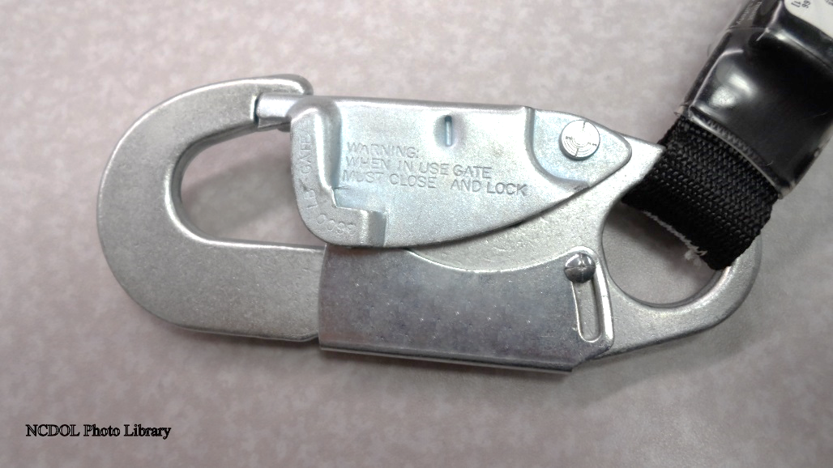
Personal Fall Arrest System
1926.502(d)
Body belts not allowed for fall arrest but may be used as a positioning device
Only locking type of snaphook can be used
Notes:
NCDOL Photo Library: Photo Taken By NCDOL Employee Tom Wilder in office
1926.502.(d)(5) Snaphooks shall be sized to be compatible with the member to which they are connected to prevent unintentional disengagement of the snaphook by depression of the snaphook keeper by the connected member, or shall be a locking type snaphook designed and used to prevent disengagement of the snaphook by the contact of the snaphook keeper by the connected member. Effective January 1, 1998, only locking type snaphooks shall be used.
LOCKING TYPE SNAPHOOK: must use two actions to open this type of snaphook so that the hook does not disengage
BODY BELT-- NOTE: The use of a body belt in a positioning device system IS ACCEPTABLE and is regulated under paragraph (e) of this section.

Slide 31
Methods of Fall Protection
1926.502(f), (g), (h), (k)
Other acceptable methods
Used under certain circumstances
Warning lines
Control access zones (CAZ)
Safety monitor
Fall protection plan
Notes:
Warning lines: a warning system used in roofing work on low-sloped roofs
Control access zones: a controlled access area used when leading edge work, overhand bricklaying or precast concrete erection activities are taking place
Safety monitor systems: a warning system used in roofing work on low-sloped roofs when roofs are 50 feet or less in width
Fall protection plan: only available to employees engaged in leading edge work, precast concrete erection work or residential construction work

Slide 32
Warning Lines
1926.502(f),1926.501(b)(10)
Used on low-sloped roofs < 4/12
Erect 6 feet from all edges
Need fall protection for last 6 feet
Used in combination with other systems
Developed by competent person
Notes:
WARNING LINE SYSTEMS: Barriers erected on a roof to warn employees that they are approaching an unprotected roof side or edge and which designates an area in which roofing work may take place without the use of a guardrail, body harness or safety net system to protect employees.
* When erected 6’ from the edge, the warning line can never be used without some other fall protection system
At 6’ from edge, must have at least safety monitoring system in place with the warning line. Less than 6’ feet from edge, must have a more restrictive fall protection system such as guardrail, PFAS, safety net.
At 15’, a warning line alone is acceptable, when combined with effective work rules – if CSHO does not identify evidence of a hazard and an exposed employee (according to our Standards Notice 65)
WARNING LINE:
Erected within 6’ of edge if no mechanical equipment in use
If mechanical equipment in use, shall erect line 6’ from edge that is parallel to direction of equipment operation and 10’ on sides perpendicular to travel direction of equipment
NOTE: Mechanical equipment shall not be used or stored in areas where safety monitoring systems are being used to monitor employees engaged in roofing operations on low slope roofs – because equipment can block the safety monitor’s view of the workers.
Flag with high visibility material – with ropes, wires, chains with supporting stanchions – flagged at not more than 6-foot intervals
Stanchions shall resist force of at least 16 pounds
Rope, wire, chain – minimum tensile strength of 500 lbs.
Line shall be no lower than 34” nor higher than 39”
WARNING LINES ALWAYS USED IN COMBINATION WITH OTHER SYSTEMS:
Warning line and guardrail system, warning line and safety net system, warning line and personal fall arrest system, warning line and safety monitoring system

Slide 33
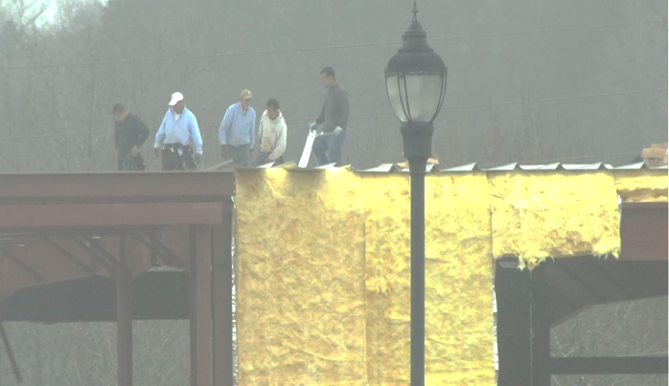
Controlled Access Zones
1926.502(g)
Used in:
Leading edge work
Overhand bricklaying
Pre-cast concrete
Only authorized persons
NCDOL Photo Library
NCDOL Photo Library
Notes:
NCDOL Photo Library: Photos Taken By NCDOL Employee Robert O’Neal – public access
CONTROLLED ACCESS ZONE: an area in which certain work (e.g. overhand bricklaying, leading edge work, precast concrete erection – where the work surface is always changing) may take place without the use of guardrail systems, personal fall arrest systems, or safety net systems and access to the zone is controlled. The CAZ shall be defined by a control line or by any other means that restricts access.
CONTROL LINES:
shall consist of ropes, wires, tapes or equivalent materials and supporting stanchions
each line flagged or clearly marked at 6 foot intervals with high-visibility material
each line rigged so lowest point (including sag) is no less than 39” and highest point is no more than 45”
each line shall have a minimum breaking strength of 200 pounds
CONTROL LINE LOCATION:
From unprotected or leading edge: shall be erected no less than 6’ nor more than 25’
To control access to areas where overhand bricklaying takes place: control line erected not less than 10’ and no more than 15’ from working edge. Only employees engaged in overhand bricklaying or related work shall be permitted in the controlled access zone.
When erecting precast concrete: control line to be erected no less than 6’ nor more than 60’ or half the length of member being erected, whichever is less, from the leading edge
-

Slide 34
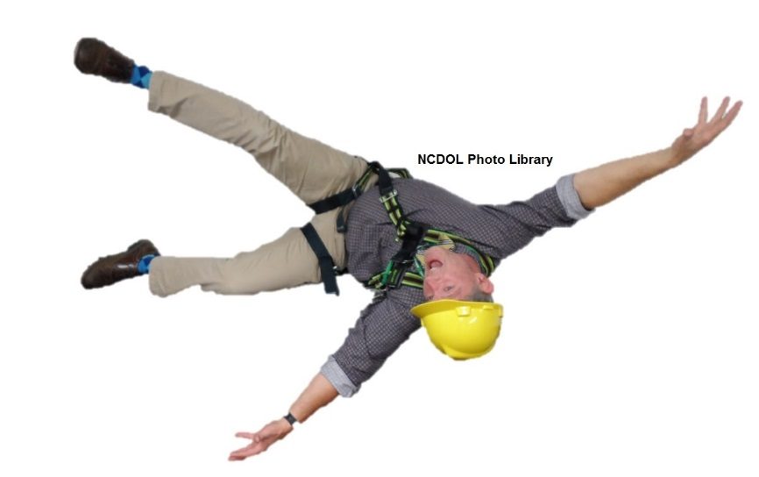
Safety Monitor System 1926.502(h)
Used on low-sloped roofs < 4/12
With roof widths < 50 feet, can use alone
Monitor must be competent person
No other responsibilities
Notes:
NCDOL Photo Library: Photo Taken By NCDOL Employees Tom Wilder and Andy Sterlen in office
SAFETY MONITORING SYSTEM: a safety system in which a competent person (safety monitor) is responsible for recognizing and warning employees of fall hazards.
Can only be used on low-sloped roofs with a pitch of < 4/12.
If the roof width is < 50’, then a safety monitor system may be used by itself. See Appendix A to Subpart M which is a non-mandatory guideline for complying with 1926.501(b)(10)
Safety monitor:
shall be competent to recognize fall hazards
shall warn the employee when it appears that the employee is unaware of a fall hazard or is acting in an unsafe manner
shall be on the same walking/working surface and within visual sighting distance of the employee being monitored – and close enough to communicate orally
shall not have other responsibilities which could take the monitor’s attention from the monitoring function
**Employees must comply with warnings from monitor**

Slide 35
Fall Protection Plan
1926.502(k)
Only for specific area or jobs
Leading edge work
Precast concrete erection work
Residential construction work
Used when conventional fall protection equipment is infeasible or creates a greater hazard
Designed by qualified person
Supervised by competent person
Notes:
FALL PROTECTION PLAN: available only to employees engaged in leading edge work, pre-cast concrete erection work, or residential construction work and who can demonstrate that it is infeasible or it creates a greater hazard to use conventional fall protection equipment.
CAN ALSO REFER TO: 1926 SUBPART M APPENDIX E – SAMPLE FALL PROTECTION PLAN – NON-MANDATORY GUIDELINES FOR COMPLYING WITH 1926.502(k)
FALL PROTECTION PLAN:
Document (for best practices) the reasons why the use of conventional fall protection systems are infeasible or why their use would create a greater hazard
1926.502(k)(1) Prepared by qualified person for each site – a qualified person is one who has education, extensive knowledge and experience and has demonstrated his/her ability to solve or resolve problems related to the subject matter
Shall identify each location where conventional fall protection methods cannot be used
1926.502(k)(4)
The implementation of the fall protection plan shall be under the supervision of a competent person.
"Competent person" means one who is capable of identifying existing and predictable hazards in the surroundings or working conditions which are unsanitary, hazardous, or dangerous to employees, and who has authorization to take prompt corrective measures to eliminate them.
Infeasible means that it is impossible to perform the construction work using a conventional fall protection system (i.e., guardrail system, safety net system, or personal fall arrest system) or that it is technologically impossible to use any one of these systems to provide fall protection.

Slide 36
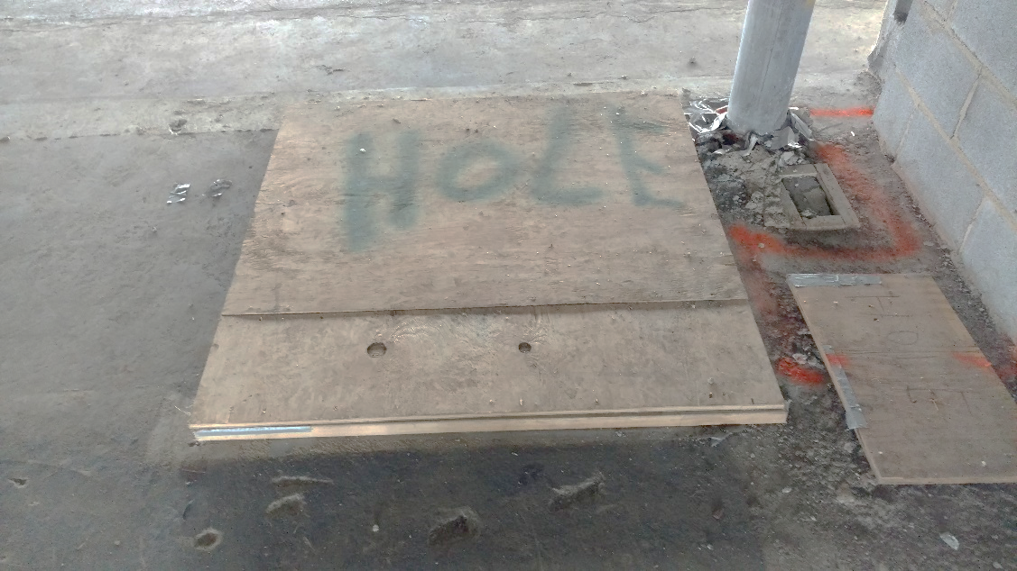
Covers for Holes
1926.502(i)
Covers must:
Withstand two times weight of expected load
Secured to prevent displacement
Marked “hole” or “cover” or color-coded
NCDOL Photo Library
Notes:
NCDOL Photo Library: Photo Taken By NCDOL Employee Robert O’Neal – Barnhill Site Building – written approval
DEFINITION of a HOLE: 2” or more in its least dimension in a floor, roof, or other walking/working surface
Covers shall withstand:
Vehicular traffic - 2 times maximum axle load of largest vehicle
Foot traffic - 2 times weight of expected load
Holes must be secured to prevent accidental displacement.
All holes shall be marked to indicate that it is a “HOLE” or “COVER”. If you have Hispanic exposed to the hazard, then the best practice would be to include “HOYO” on the cover as well.

Slide 37
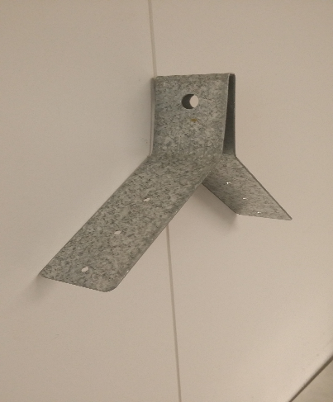
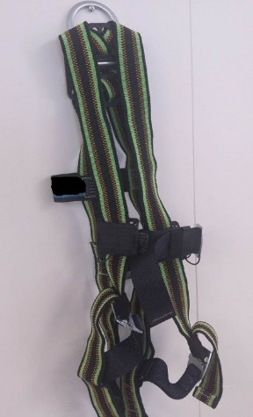
Personal Fall Arrest System 1926.502(d)
Anchorage Connectors
Harness
NCDOL Photo Library
NCDOL Photo Library
NCDOL Photo Library
Notes:
NCDOL Photo Library: Photo Taken By NCDOL Employee Reggie Matthews in office
PERSONAL FALL ARREST SYSTEM: used to arrest an employee in a fall from a working level. It consists of an anchorage, connectors, a body harness and may include a lanyard, deceleration device, lifeline, or suitable combinations of these.
CAN ALSO REFER TO 1926 SUBPART M APPENDIX C on Personal Fall Arrest Systems – non-mandatory guidelines for complying with 1926.502(d)
1) ANCHORAGE (anchor points): a secure point of attachment for lifelines, lanyards or deceleration devices
2) CONNECTOR (fall arrest connection devices): used to couple (connect) parts of the personal fall arrest system and positioning device systems together (shock-absorbing lanyards, retractable lifelines, rope grabs, dee-rings, snap-hooks, etc.)
-ROPE GRAB: a deceleration device which travels on a lifeline and automatically, by friction, engages the lifeline and locks to arrest the fall of an employee
-RETRACTABLE: like a self-retractable lifeline
HARNESS: Full-body harnesses wrap around the waist, shoulders and legs. A D-ring located in center of back provides a connecting point for lanyards or other fall arrest connection devices. In the event of a fall, a full-body harness distributes the force of the impact throughout the trunk of the body—not just in the abdominal area. This allows the pelvis and shoulders to help absorb the shock, reducing the impact to the abdominal area.
1926.502(d)(15)
Anchorages used for attachment of personal fall arrest equipment shall be independent of any anchorage being used to support or suspend platforms and capable of supporting at least 5,000 pounds (22.2 kN) per employee attached, or shall be designed, installed, and used as follows: as part of a complete personal fall arrest system which maintains a safety factor of at least two; and under the supervision of a qualified person.
1926.502(d)(1) Connectors shall be drop forged, pressed or formed steel, or made of equivalent materials.
1926.502(d)(2) Connectors shall have a corrosion-resistant finish, and all surfaces and edges shall be smooth to prevent damage to interfacing parts of the system.

Slide 38
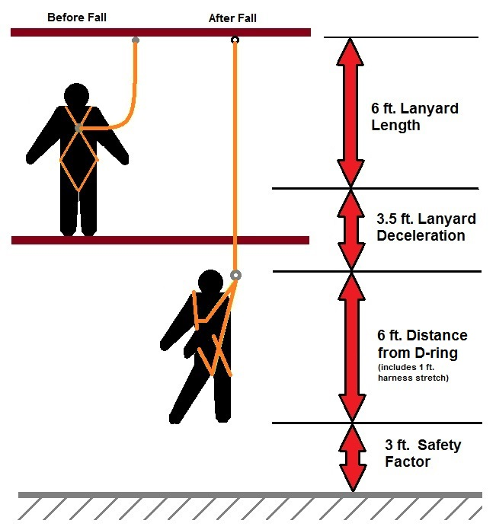
Personal Fall Arrest Systems
NCDOL Photo Library
Notes:
NCDOL Photo Library: Graphic created by NCDOL employee Andy Sterlen on his NCDOL computer located at the NCDOL office building at 111 Hillsborough St, Raleigh, NC on 01/02/18.
This diagram shows an employee’s position before and after a fall. Note the distances that must be considered with determining the anchorage height. Consider a 3 foot minimum safety factor between the employee’s feet and the lower surface after a fall.
For this example, the employee is 6 feet tall and the D-ring is located at an approximate height of 5 feet. However, due to harness stretch during a fall, this example shows a distance of 6 feet between the D-ring and the employee’s feet.
This lanyard is 6 feet long and has a deceleration distance of 3.5 feet
For this example, the anchorage position must be located at a minimum height of 18.5 feet or the employee could hit the ground.
By having the anchorage point above the employee’s head, the fall distance (from walking working surface to fall resting point) is minimized. If the anchorage point was the same, but the employee was working on the top level shown in the slide, the fall distance for the employee would be greater even though the anchorage and final resting point would be the same.

Slide 39
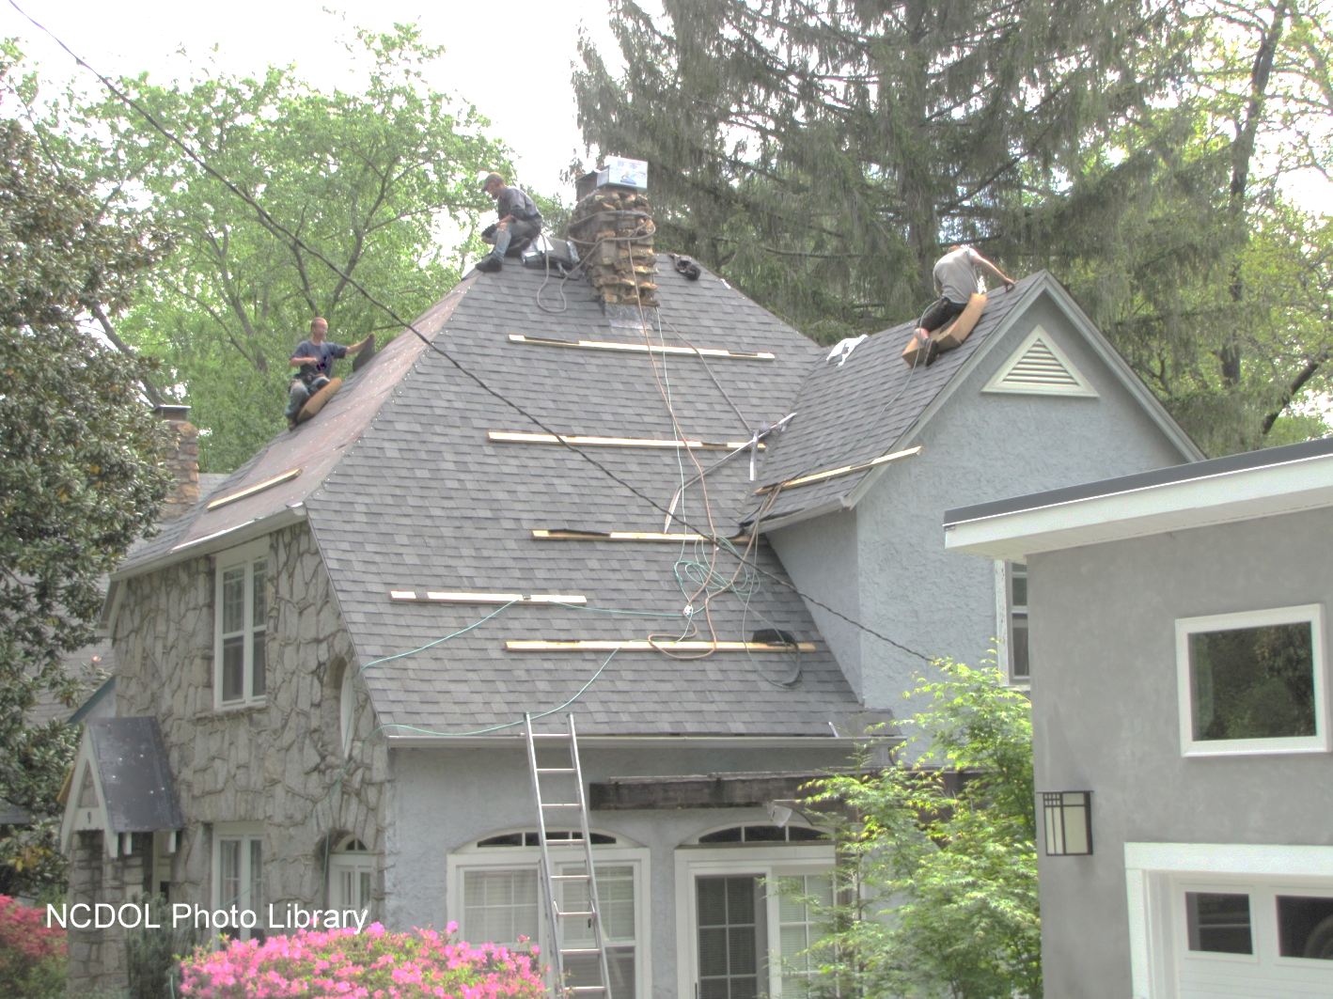
Personal Fall Arrest Systems
Is this correct?
Notes:
NCDOL Photo Library: Closed Case# 317714681
No. Several issues in photo for discussion including lack of or improper use of fall protection. Also, note improper ladder use.

Slide 40
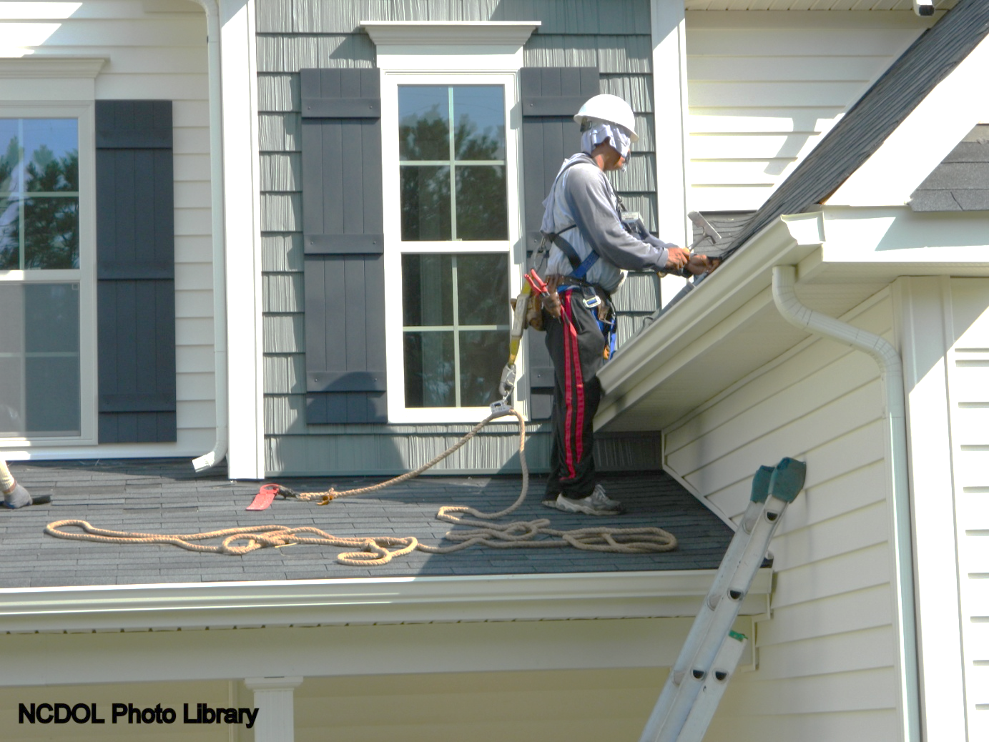
Personal Fall Arrest Systems
Is this correct?
Notes:
NCDOL Photo Library: Closed Case# 316595651
No, He is not connected

Slide 41
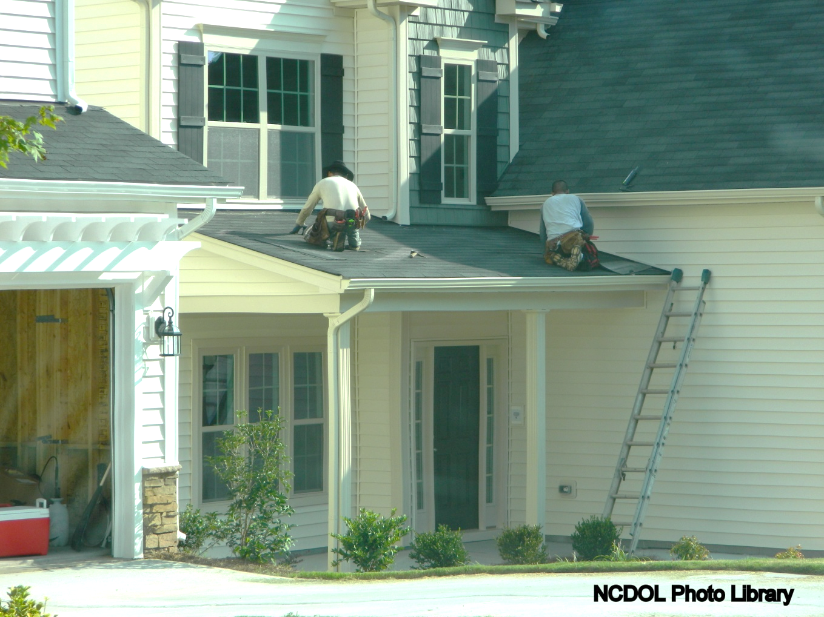
Personal Fall Arrest Systems
Is this correct?
Notes:
NCDOL Photo Library: Closed Case# 316595651
No. Workers are not tied off and ladder is not correctly set up to access the roof.

Slide 42
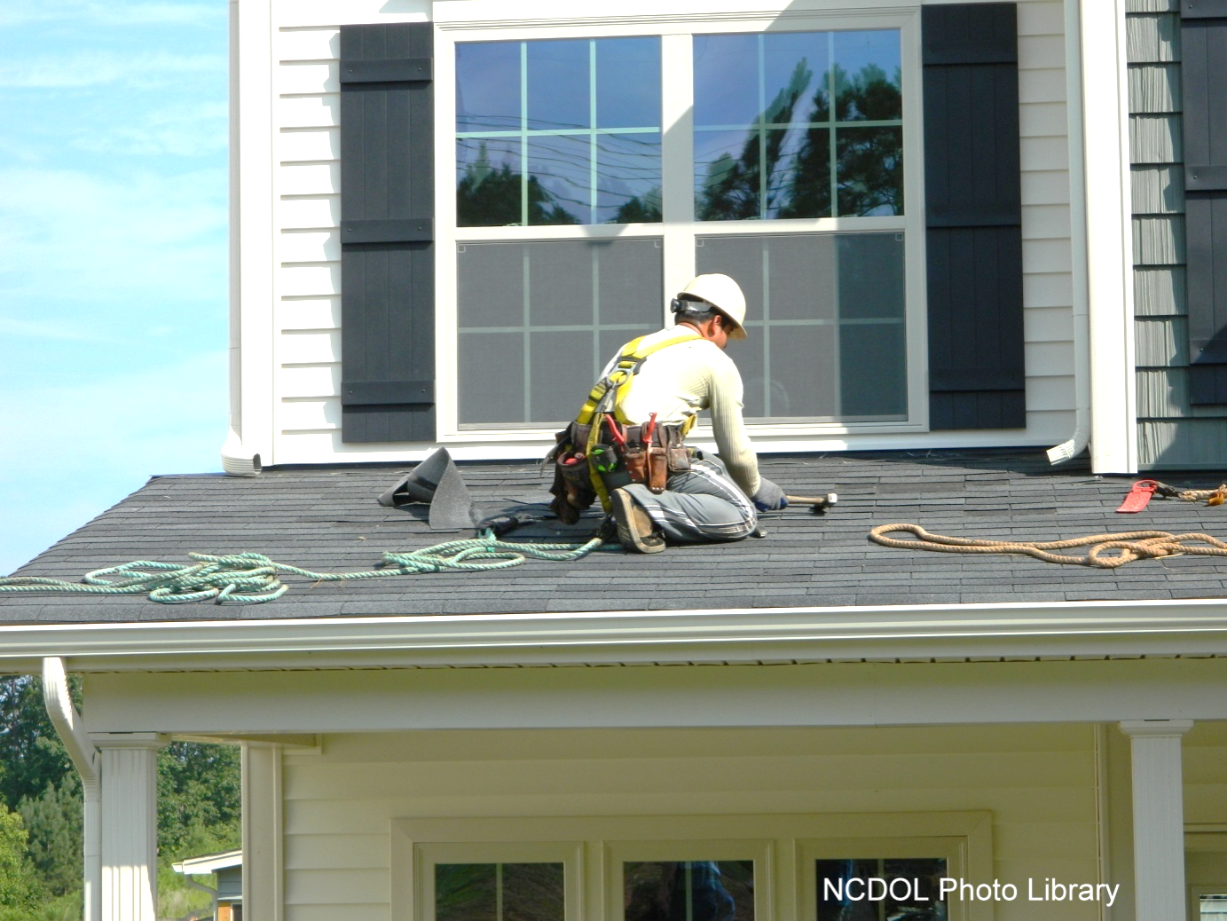
Personal Fall Arrest Systems
Is this correct?
Notes:
NCDOL Photo Library: Closed Case# 316595651
No. The worker has way to much length to the rope which would allow him to fall to the ground. The rope also seems to not be connected to an anchor point.

Slide 43
Personal Fall Arrest Systems
Is this correct?
Notes:
NCDOL Photo Library: Closed Case# 316595743
A lanyard seems to be attached to D-ring. What is the worker tied off to? Is the worker protected from falling and hitting the lower level?

Slide 44
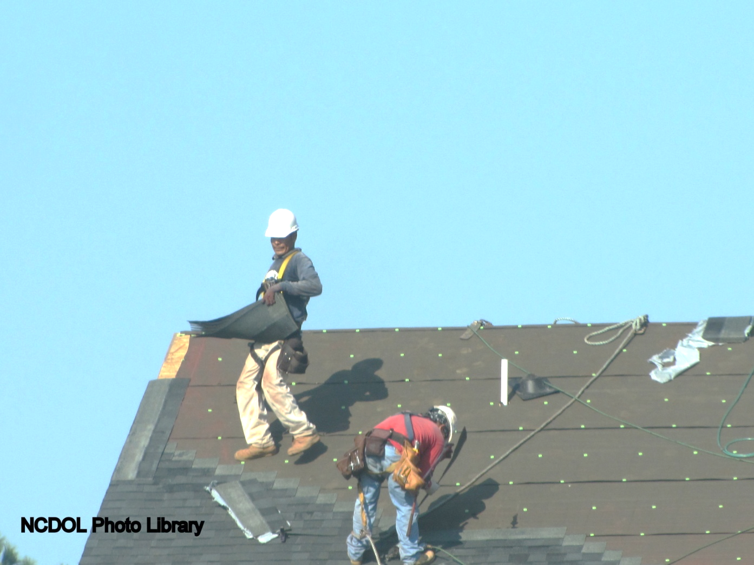
Personal Fall Arrest Systems
Is this correct?
Notes:
NCDOL Photo Library: Closed Case# 316595743
No. The worker is carrying a load on a high pitch roof with no protection.

Slide 45
Positioning Device System 1926.502(e)
Allows an employee to be supported on an elevated vertical surface
No more than 2 feet freefall
Inspected before each use
Safety belts okay for use
Notes:
Positioning device system means a body belt or body harness system rigged to allow an employee to be supported on an elevated vertical surface, such as a wall, and work with both hands free while leaning.
CAN LOOK AT SUBPART M APPENDIX D – on Positioning device systems – non-mandatory guidelines for complying with 1926.502(e)

Slide 46
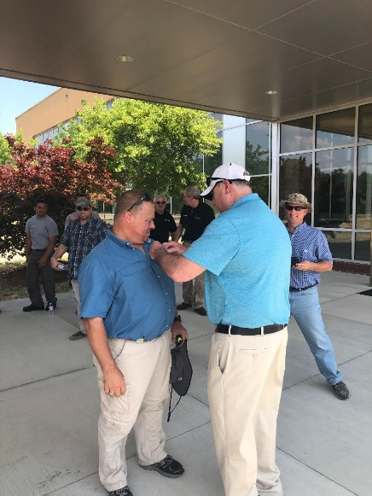
Training Requirements 1926.503
Employer must:
Provide a training program
Ensure each employee has been trained
Provide written certification of training
Retrain where necessary
NCDOL Photo Library
Notes:
Photo: Drone Training June 2019, Taken by Cory Dunphy, NCDOL Employee
TRAINING PROGRAM: The employer shall provide a training program for each employee who might be exposed to fall hazards. The program shall enable each employee to recognize the hazards of falling and shall train each employee in the procedures to be followed in order to minimize these hazards. It enables each employee to recognize hazards and know procedures to minimize these hazards.
The employer shall assure that each employee has been trained by a COMPETENT PERSON qualified in the following areas:
- nature of fall hazards in the work area
- correct procedures for use of fall protection systems
- correct procedures for handling and storage of equipment and materials
- role of employees in fall protection plans
- knowledge of standards contained in subpart M
Written certification: preparation of certification record with name of employee, date of training and signature of person who conducted the training or signature of employer
Retraining: where previous training is obsolete, where equipment has changed, where the employee has not retained knowledge from previous training

Slide 47
Summary
In this course, we discussed:
Fall hazards in construction
Subpart M requirements
Applying fall protection standards to construction sites
Notes:
Summarize the topics discussed and prompt the student to ask questions.

Slide 48
Thank You For Attending!
Final Questions?

