Slide 1
Health Hazards
Special Emphasis Program
Presented by:
Notes:
Revised 12/2021
The information in this presentation is provided voluntarily by the N.C. Department of Labor, Education Training and Technical Assistance Bureau as a public service and is made available in good faith. This presentation is designed to assist trainers conducting OSHA outreach training for workers. Since workers are the target audience, this presentation emphasizes hazard identification, avoidance, and control – not standards. No attempt has been made to treat the topic exhaustively. It is essential that trainers tailor their presentations to the needs and understanding of their audience.
The information and advice provided on this Site and on Linked Sites is provided solely on the basis that users will be responsible for making their own assessment of the matters discussed herein and are advised to verify all relevant representations, statements, and information.
This presentation is not a substitute for any of the provisions of the Occupational Safety and Health Act of North Carolina or for any standards issued by the N.C. Department of Labor. Mention of trade names, commercial products, or organizations does not imply endorsement by the N.C. Department of Labor.

Slide 2
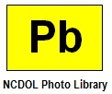
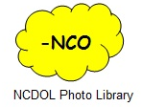
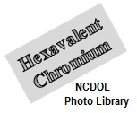
Objectives
After this course, students will be able to:
Understand the NCDOL Health Hazards Special Emphasis Program (SEP) requirements for:
Lead
Asbestos
Hexavalent chromium (CrVI)
Isocyanates
Silica
Recognize exposure effects, health effects and abatement methods for each

Slide 3
Health Hazards SEP
Overexposures to these chemicals can lead to serious health effects.
OSH Division has increased the number of inspections to focus on industries that use these chemicals and substances.

Slide 4
Health Hazards SEP
Lead
29 CFR 1910.1025
29 CFR 1926.62

Slide 5
Lead Standard
1910.1025
1926.62
Means metallic lead, all inorganic lead compounds, and organic lead soaps
Excluded from this definition are all other organic lead compounds.
Exposure sources
Lead-based paint, batteries, battery recycling, foundries, welding/cutting and brazing
Lead shot, indoor/outdoor shooting ranges

Slide 6
Lead Health Effects
1910.1025, Appendix A
1926.62, Appendix A
Acute effects: Show up sooner usually after high exposure.
Symptoms can include metallic taste, stomach pain, vomiting, diarrhea and black stools which could potentially cause intoxication, coma, respiratory arrest, or death.
Short term occupational exposures of this magnitude are highly unusual, but not impossible.

Slide 7
Lead Health Effects
1910.1025, Appendix A
1926.62, Appendix A
Chronic effects: Take longer to develop and often are attributed to lower cumulative exposures over time.
Symptoms can include tiredness, weakness, weight loss, insomnia, headache, nervous irritability, fine tremors, numbness, dizziness, anxiety and hyperactivity which could potentially lead to:
Damage of the nervous system and brain
Anemia
Kidney disease

Slide 8
Lead Exposure Limits
1910.1025
1926.62
Permissible exposure limit (PEL) = 50 µg/m³ as an 8-hour time-weighted average (TWA)
Employers shall implement engineering controls and safe work practices to prevent exposure
Employers shall provide protective clothing and where necessary, and respiratory protection in accordance with 29 CFR 1910.134
Action level (AL) = 30 µg/m³ as an 8-hour TWA

Slide 9
Medical Surveillance
1910.1025
1926.62
In General Industry, employer shall institute a medical surveillance program for employees who are or may be exposed above the action level for more than 30 days per year.
Appendix C - Medical Surveillance Guidelines
In Construction, employer shall provide initial medical surveillance for any employee exposed at or above the action level for any one day.

Slide 10
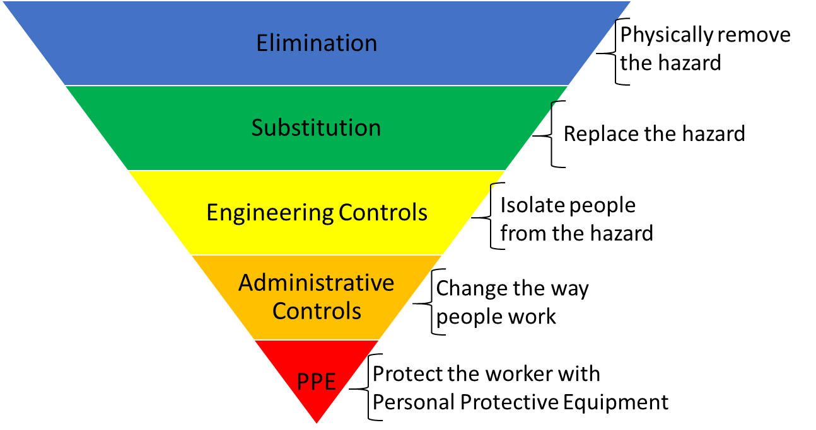
Hierarchy of Controls
1910.1025
1926.62

Slide 11
Abatement Methods
1910.1025
1926.62
Elimination
Substitution
Engineering controls
Mechanical ventilation
Isolation
Administrative controls
Housekeeping
Personal hygiene practices
Designated break areas
Personal protective equipment (PPE)
Respiratory protection
Protective work clothing

Slide 12
Health Hazards SEP
Asbestos
29 CFR 1910.1001
29 CFR 1926.1101

Slide 13
Asbestos
1910.1001
1926.1101
A group of naturally occurring fibrous silicate minerals with useful properties such as thermal insulation, chemical and thermal stability, and high tensile strength.
Used in building materials for resistance against heat and corrosion.
Asbestos includes:
Chrysotile
Amosite
Crocidolite
Tremolite
Anthophyllite
Actinolite
Nova Development
Notes:
13

Slide 14
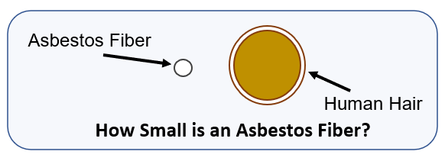
Asbestos
1910.1001
1926.1101
Airborne fibers range from 5 µm or greater, with a length-to-diameter ratio of at least 3 to 1.
Notes:
14

Slide 15
Asbestos
1910.1001
1926.1101
ACM: “Asbestos-containing material,” any material containing >1% asbestos.
PACM: “Presumed asbestos-containing material” – thermal system insulation and surfacing material found in buildings constructed no later than 1980.
Notes:
15

Slide 16
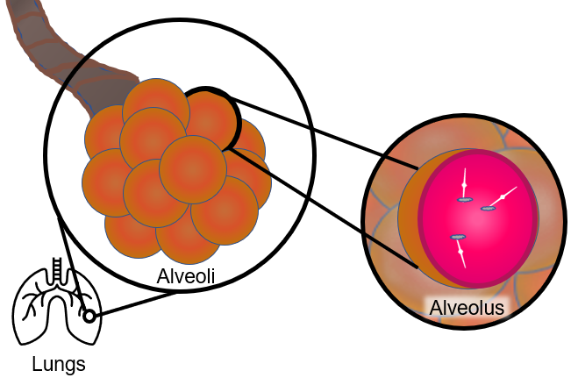
Health Effects
Asbestos particles are breathed into the smallest part of the lungs causing permanent scarring, stiffening and damaging your lungs.

Slide 17
Asbestos Health Effects
1910.1001
1926.1101
Asbestosis: A serious, progressive, long-term non-cancer disease of the lungs.
Lung Cancer: Causes the largest number of deaths related to asbestos exposure.
Most common symptoms of lung cancer are coughing and a change in breathing.
Mesothelioma: A rare form of cancer found in the thin lining (membrane) of the lung, chest, abdomen, and heart.
Most cases are linked to asbestos exposures.
Notes:
17

Slide 18
Exposure Limits
1910.1001
1926.1101
Permissible exposure limit
0.1 fiber per cubic centimeter (f/cc) of air as an 8-hour TWA.
Excursion limit
Not more than 1 f/cc averaged over 30 minutes.
Monitoring
Initially for workers who are or may be exposed at or above the PEL and/or above the excursion limit.
Periodic if above PEL or excursion limit.

Slide 19
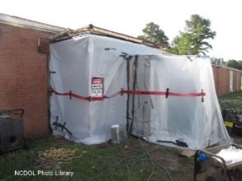
Responsibility
1910.1001
1926.1101
Building/facility owner
Removal/abatement of asbestos is covered by 29 CFR 1926 (Construction)
Must adhere to:
Multi-employer worksite
Hazards abated by contractor who created.
Inform others of measures to control exposures.
Adjacent employer will check containment.
General contractor (GC) requires compliance.
Competent person
Notes:
19

Slide 20
Medical Surveillance
1910.1001
1926.1101
Required when above PEL/excursion limit
Pre-placement examinations
Medical/work history
Complete physical exam with emphasis on respiratory system, cardiovascular system and digestive tract
Completion of questionnaire – Appendix D
Chest X-Ray (Roentgenogram)
Pulmonary function test (PFT)
Any additional tests required by the Physician
or other Licensed Healthcare Professional (PLHCP)
Periodic exam (annually)
Upon termination of employment (1910)

Slide 21
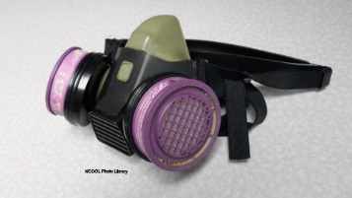
Respirator Selection
1910.1001
1926.1101
When is respiratory protection required?
Above PEL
Based on Class of work performed
Provided in accordance with 29 CFR 1910.134 (b) - (d) (except (d)(1)(iii)), and (f) - (m)
Proper selection per 29 CFR 1910 or 29 CFR 1926
High efficiency particulate air (HEPA) filters for all air purifying respirators (APR)
No filtering face pieces (dust masks)

Slide 22
Abatement
1910.1001
1926.1101
Elimination
Substitution
Engineering controls
Mechanical ventilation
Administrative controls
Procedures
Housekeeping
Hygiene facilities
PPE
Respiratory protection
Protective work clothing

Slide 23
Health Hazards SEP
Hexavalent Chromium
29 CFR 1910.1026
29 CFR 1926.1126

Slide 24
Hexavalent Chromium
1910.1026
1926.1126
Toxic form of chromium metal that is generally man-made.
Used in many industrial applications primarily for its anti-corrosive properties.
Can be created during certain “hot work” processes where the original form of chromium was not hexavalent.
Notes:
24

Slide 25
Examples of Cr(VI) Compounds
1910.1026
1926.1126
Ammonium dichromate
Calcium chromate
Chromium trioxide or chromic acid
Lead chromate (chromium yellow)
Potassium chromate
Potassium dichromate
Sodium chromate
Strontium chromate
Zinc chromate
(NH₄)₂Cr₂O₇
CaCrO₄
CrO₃
PbCrO₄
K₂CrO₄
K₂Cr₂O₇
Na₂CrO₄
SrCrO₄
ZnCrO₄
Notes:
25

Slide 26
Affected Operations
1910.1026
1926.1126
Electroplating
Welding on stainless steel or Cr(VI) painted surfaces
Painting
Aerospace
Auto body repair
Chromate pigment and chemical production
Chromium dye and catalyst production
Glass manufacturing
Plastic colorant production
Construction
Refractory brick restoration
Paint removal from bridges
Traffic painting
Notes:
26

Slide 27
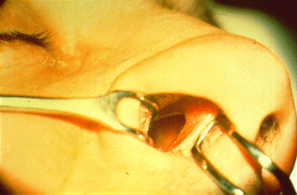
Health Effects
1910.1026
1926.1126
Lung cancer (via inhalation of Cr(VI)
Irritation or damage to the nose, throat, and lung (respiratory tract) at high levels
Irritation or damage to the eyes and skin if contact at high concentrations
“Chrome Hole” – Employee was chrome plating small appliance parts

Slide 28
Major Provisions
1910.1026
1926.1126
Scope
Permissible exposure limit
Exposure determination
Recordkeeping
Methods of compliance
Respiratory protection
Protective work clothing
and equipment
*General Industry only
Hygiene areas and practices
Medical surveillance dates
Communication of hazards
Regulated areas*
Housekeeping*
Notes:
28

Slide 29
Exposure Limits
1910.1026
1926.1126
Permissible exposure limit
5 µg/m³, calculated as an 8-hour time-weighted average
Action level
2.5 µg/m³
Exposure determination
See paragraph (d) for more specifics

Slide 30
Monitoring
1910.1026
1926.1126
Scheduled
Initial monitoring indicates exposures are:
Below the AL: monitoring can be discontinued
At or above the AL: monitor every 6 months
Above the PEL: monitor every 3 months
Periodic personal monitoring
Performance-oriented option
To determine 8-hour TWA for each employee
based on any combination of the following:
Air-monitoring data
Historical monitoring data
Objective data

Slide 31
Regulated Areas
1910.1026(e)
General Industry employers only
Areas where exposures exceed or can be reasonably expected to exceed the PEL.
Must be demarcated from other areas.
Must limit access to employees who have a need to be there.

Slide 32
Medical Surveillance
1910.1026
1926.1126
Occupationally exposed for 30 days or more at or above the AL
Conducted within 30 days after initial assignment or exposure of uncontrolled release
Within 30 days after PLHCP written medical opinion
Employee shows signs and symptoms of adverse health effects or signs and symptoms of exposure
Termination of employee
Annually

Slide 33
Abatement
1910.1026
1926.1126
Elimination
Substitution
Engineering controls
Mechanical ventilation
Administrative controls
Housekeeping
Hygiene facilities
Regulated areas of work
PPE
Respiratory protection
Protective work clothing

Slide 34
Health Hazards SEP
Isocyanates
29 CFR 1910.1000
29 CFR 1926.55

Slide 35
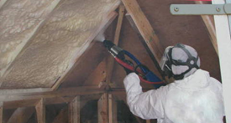
Isocyanates
1910.1000
1926.55
Compounds containing the isocyanate group
(-NCO)
React with compounds containing alcohol (hydroxyl) groups to produce polyurethane polymers, which are components of polyurethane foams, thermoplastic elastomers, spandex fibers, and polyurethane paints.
NCDOL Photo Library

Slide 36
Isocyanates
1910.1000
1926.55
Isocyanates can also be found in raw materials that make up all polyurethane products.
PELs/Threshold Limit Values (TLV), are very low (<1 ppm).
NCDOL Photo Library

Slide 37
Health Effects
1910.1000
1926.55
Health effects of isocyanate exposure include irritation of skin and mucous membranes, chest tightness, and difficult breathing.
Isocyanates include compounds classified as potential human carcinogens and are known to cause cancer in animals.
Main effects of hazardous exposures are occupational asthma and other lung problems, as well as irritation of the eyes, nose, throat, and skin.

Slide 38
Medical Surveillance
1910.1000
1926.55
It is recommended that workers exposed
to isocyanates at or above the PEL or TLV undergo annual medical examinations and health surveillance under the supervision of a PLHCP.
Physical examination should detail the workers demographic and occupational history.
A pulmonary function test (spirometry) is recommended as well as a blood sample to monitor the systemic effects.

Slide 39
Abatement
1910.1000
1926.55
Elimination
Substitution
Engineering controls
Mechanical ventilation
Administrative controls
Housekeeping
Personal hygiene
Regulated areas of work
PPE
Respiratory protection
Protective work clothing

Slide 40
Health Hazards SEP
Silica
29 CFR 1910.1053
29 CFR 1926.1153

Slide 41
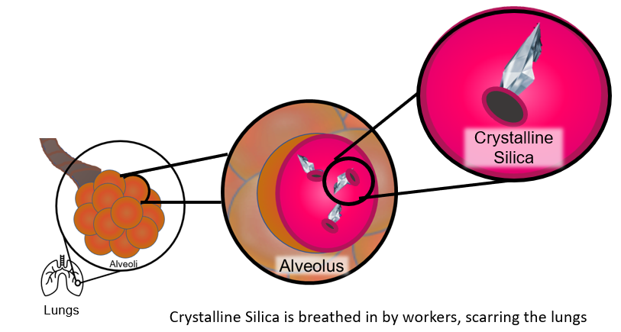
Silica
1910.1053
1926.1153
Silicosis, an irreversible but preventable disease, is the illness most closely associated with occupational exposure to the material, which also is known as silica dust.

Slide 42
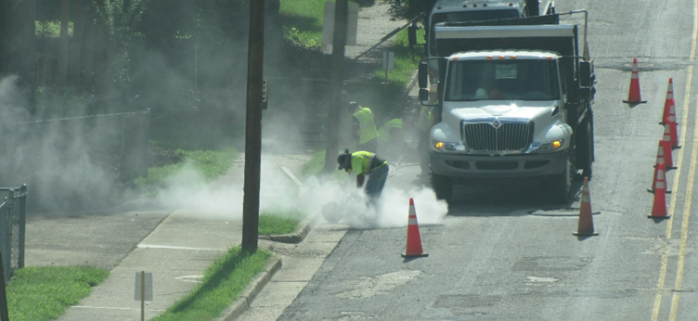
Silica
1910.1053
1926.1153
If employer only suspects that silica is a hazard at the workplace, employer is still required to communicate this potential hazard to all employees.
Examples include:
Abrasive blasting
Blast furnaces
Cement manufacturing
Ceramics, clay, and pottery
NCDOL Photo Library

Slide 43
Silica
1910.1053
1926.1153
Concrete mixing
Demolition
Electronics industry
Foundry industry: grinding, molding, shakeout, core room (high risk)
Hand molding, casting, and forming
Jack hammer operations
Manufacturing abrasives, paints, soaps, and glass
Mining
Rolling and finishing mills
Sandblasting
Setting, laying, and repairing railroad track

Slide 44
Health Effects
1910.1053
1926.1153
Occupational exposure to respirable crystalline silica is associated with the development of silicosis, lung cancer, pulmonary tuberculosis, and airway diseases.
Exposures may also be related to the development of autoimmune disorders, chronic renal disease, and other adverse health effects.
USDOL Photo Archive

Slide 45
Silica Exposure Limits
1910.1053
1926.1153
AL = 25 µg/m³ as an 8-hour TWA
Written Exposure Control Plan (ECP)
PEL = 50 µg/m³ as an 8-hour TWA
Employers must use engineering controls to prevent or reduce exposure
Respiratory protection is required when exposure remains above PEL after engineering controls are utilized or when required by Table 1.

Slide 46
Medical Surveillance
1910.1053
1926.1153
At no cost to the employee.
At a reasonable time and place.
General Industry
When exposed at or above 25 µg/m³ for 30 or more days for any 12 consecutive months.
Construction
When employee is required to wear a respirator 30 or more days for any 12 consecutive months.

Slide 47
Specific Control Methods
1926.1153(c)(1)
In Construction
Table 1
18 specific tasks
Identifies specific engineering controls to use
Water delivery systems
Dust collection systems
Fully and properly implemented controls listed
Do not have to comply with PEL
Do not have to conduct exposure assessment

Slide 48
Table 1 - Example
1926.1153(c)(1)
Equipment/Task | Engineering and work practice control methods | Required respiratory protection and minimum assigned protection factor (APF)
 |  | ≤ 4 hours/shift | >4 hours/shift
Handheld power saws (any blade diameter) | Use saw equipped with integrated water delivery system that continuously feeds water to the blade Operate and maintain tool in accordance with manufacturer's instructions to minimize dust emissions:
 | When used outdoors | None | APF 10
 | When used indoors or in an enclosed area | APF 10 | APF 10

Slide 49
Abatement
1910.1053
1926.1153
Elimination
Substitution
Engineering controls
Mechanical ventilation
Administrative controls
Housekeeping
Personal hygiene
Regulated areas of work
PPE
Respiratory protection
Protective work clothing

Slide 50
Summary
In this course, we discussed the following:
NCDOL Health Hazards Special Emphasis Program for:
Lead
Asbestos
Hexavalent chromium (CrVI)
Isocyanates
Silica
Exposures, health effects and abatement methods for each

Slide 51
Thank You For Attending!
Final Questions?

