Slide 1
Understanding the OSHA Inspection Process
Presented by:
Notes:
Revised 10/2021
The information in this presentation is provided voluntarily by the N.C. Department of Labor, Education Training and Technical Assistance Bureau as a public service and is made available in good faith. This presentation is designed to assist trainers conducting OSHA outreach training for workers. Since workers are the target audience, this presentation emphasizes hazard identification, avoidance, and control – not standards. No attempt has been made to treat the topic exhaustively. It is essential that trainers tailor their presentations to the needs and understanding of their audience.
The information and advice provided on this Site and on Linked Sites is provided solely on the basis that users will be responsible for making their own assessment of the matters discussed herein and are advised to verify all relevant representations, statements, and information.
This presentation is not a substitute for any of the provisions of the Occupational Safety and Health Act of North Carolina or for any standards issued by the N.C. Department of Labor. Mention of trade names, commercial products, or organizations does not imply endorsement by the N.C. Department of Labor.

Slide 2
Objectives
At the end of this course, students will be able to:
Understand different inspection types
Identify what generates an inspection
Understand the procedures involved as a compliance inspection
Describe the rights and responsibilities of employers and employees
Understand the post-inspection process

Slide 3
Amputations Special Emphasis Program
Goal to reduce occupational exposures to amputations
Struck by and caught between injuries
Lockout/tagout
Machine guarding
Increase outreach to employers and employees
Training events (Internal and external)
Compliance inspections
Consultation visits
Publications
Amputations must be reported within 24 hours

Slide 4
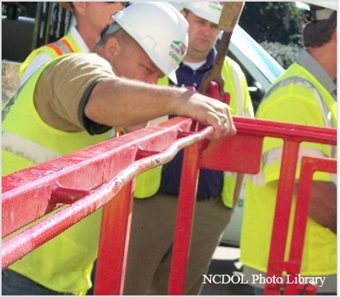
Inspection Types/Priorities
Imminent danger
Fatality/catastrophe
Complaints
Referrals
Follow-up
Programmed

Slide 5
Programmed
Special Emphasis Programs (SEP)
Amputations
Construction
Logging/Arboriculture
Long Term Care
Health Hazards (e.g., lead, asbestos, silica, hexavalent chromium, isocyanates)
Food Manufacturing
Grocery and Related Product
Merchant Wholesalers

Slide 6
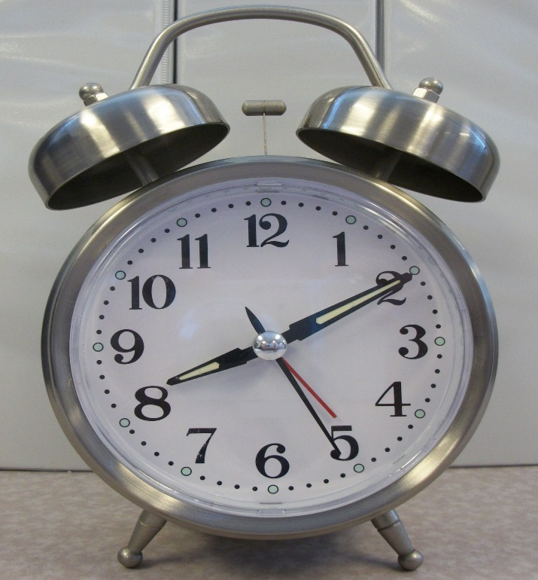
Workplace Entry
Normal working hours
Credentials
Refusal
Interference
Special situations
Inspect on 2nd/3rd shift
Security clearance
Sampling
NCDOL Photo Library

Slide 7
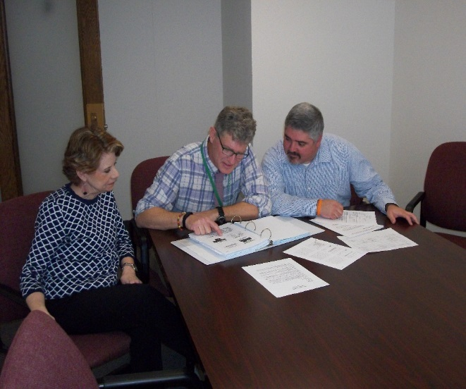
Opening Conference
Purpose and scope
Records inspection
Walk around representatives
Trade secrets
NCDOL Photo Library

Slide 8
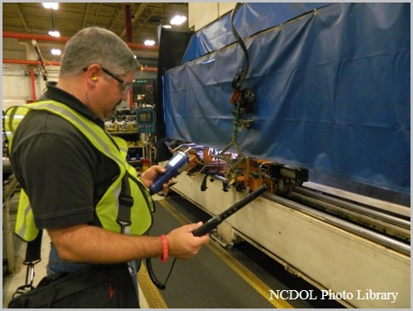
Walk Around Inspection
Scope
Program evaluation
Safety/health inspection
Interviews
Photographs
Nova Development

Slide 9
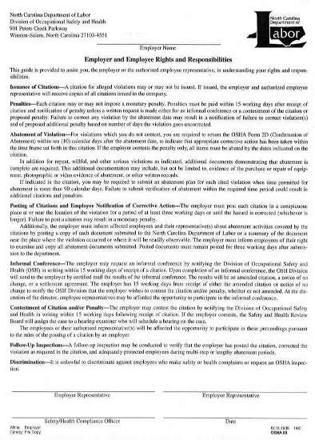
Closing Conference
Discuss findings and potential alleged violations
Employer and employee rights and responsibilities
Form 59
NCDOL Photo Library
Nova Development

Slide 10
After the Inspection
Citations or in-compliance
Abatement
Violation types
Penalties
Informal conference
Contestment
Discrimination
NCDOL Photo Library

Slide 11
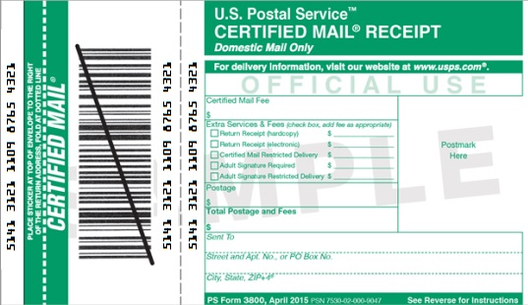
Citations
Issuance
Received by certified mail
Posting
Three days or until the hazards are abated, whichever is longer

Slide 12
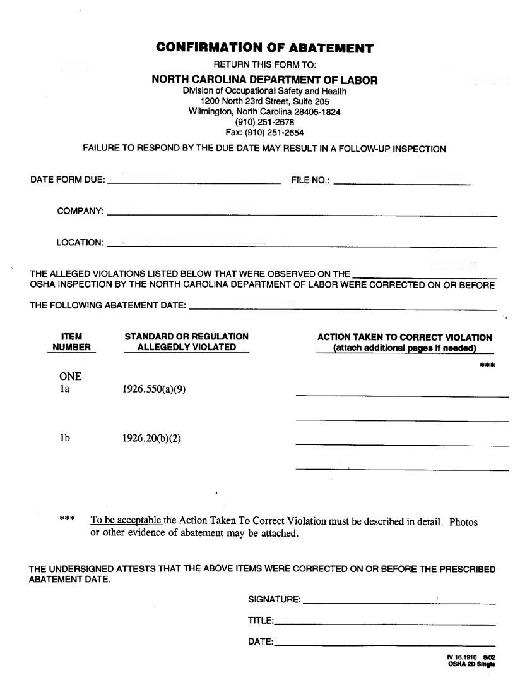
Abatement
Date - extension
OSHA Form 2D
Follow-up inspection
NCDOL Photo Library

Slide 13
Violations
Types of violations
Serious
“Deemed to exist in the place of employment if there is substantial probability that death or serious physical harm could result.…”
Non-serious
“Situations where the accident or illness that would be most likely to result from a hazardous condition would probably not cause death or serious physical harm....”

Slide 14
Violations
Willful
When evidence shows either an intentional violation of the act or plain indifference to its requirements.
.
Criminal-Willful
Employer willfully violates any standard which causes death of an employee and is found guilty.
Repeat
Employer has been cited previously for a substantially similar condition.
Failure to Abate
Employer has not corrected a previously cited violation which has become final order.

Slide 15
Hazard Assessments
Severity
Most likely an injury or illness resulting from exposure
Probability
Number of employees exposed
Frequency and duration of exposure
Employee distance from the hazard
Other factors

Slide 16
Maximum Penalties
Willful – $70,000
Serious – $7,000 (*exception)
Repeat – $7,000 (x2, x5, x10)
Failure to Abate – $7,000/day
Non-serious – May have monetary value

Slide 17
Penalty Adjustment Factors
Size (# of Employees) | 251+ | 176-250 | 131-175 | 91-130 | 56-90 | 26-55 | 1-25
 | 0% | 10% | 20% | 30% | 40% | 50% | 60%
History |  |  |  | 10%
Safety and Health Programs |  |  |  | 0%, 10%, 25%, 40%
Notes:
17

Slide 18
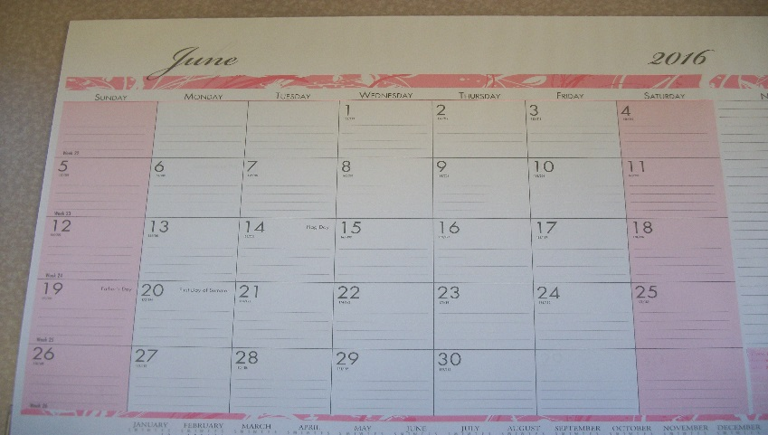
Informal Conference
Time frame
Post request
Settlement agreement - posted
Notice of amended citations
Notice of no change
NCDOL Photo Library
Notes:
In minimal attendance at the informal conference there will be one representative from the employer and the district OSH supervisor. In addition, the employer may bring others such as engineers, employee reps, etc. Having an informal conference does not negate the employer’s right to contest.

Slide 19
Contestment
Any part of citation
Written
Time frame
Administrative Law Judge
OSH Review Commission
NCDOL Photo Library

Slide 20
Discrimination
It is unlawful to discriminate against employees who file safety or health complaints or request an OSHA inspection.
NCDOL Photo Library

Slide 21
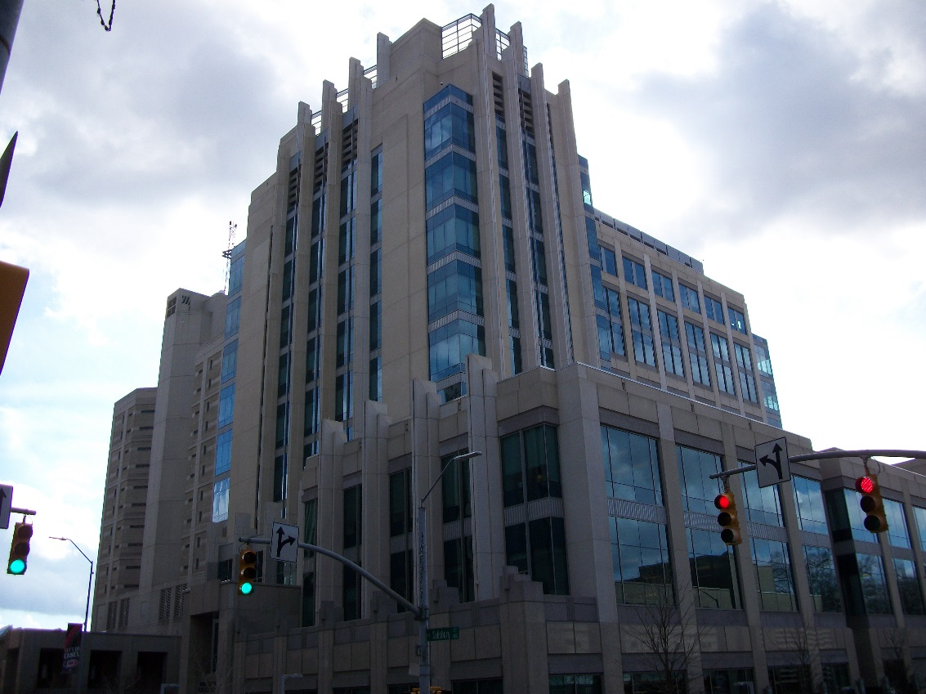
Other Issues
Criminal penalties
Wake Co. Justice Center
NCDOL Photo Library
Notes:
21

Slide 22
Summary
In this course, we discussed:
Inspection types
What generates an inspection
Procedures of a compliance inspection
Rights and responsibilities of employers and employees
What happens after an inspection
Wake Co. Justice Center
NCDOL Photo Library
Notes:
22

Slide 23
Thank You For Attending!
Final Questions?

