Slide 1
Struck By/Caught Between
Presented by:
Notes:
Revised: 10/2021
The information in this presentation is provided voluntarily by the N.C. Department of Labor, Education Training and Technical Assistance Bureau as a public service and is made available in good faith. This presentation is designed to assist trainers conducting OSHA outreach training for workers. Since workers are the target audience, this presentation emphasizes hazard identification, avoidance, and control – not standards. No attempt has been made to treat the topic exhaustively. It is essential that trainers tailor their presentations to the needs and understanding of their audience.
The information and advice provided on this Site and on Linked Sites is provided solely on the basis that users will be responsible for making their own assessment of the matters discussed herein and are advised to verify all relevant representations, statements, and information.
This presentation is not a substitute for any of the provisions of the Occupational Safety and Health Act of North Carolina or for any standards issued by the N.C. Department of Labor. Mention of trade names, commercial products, or organizations does not imply endorsement by the N.C. Department of Labor.

Slide 2
Objectives
After this course, students will be able to:
Recognize potential struck-by/caught-in or between situations
Identify struck-by/caught-in or between hazards
Evaluate control measures for struck-by/caught-in or between hazards
NCDOL Photo Library

Slide 3
Amputations Special Emphasis Program
Goal to reduce occupational exposures to amputations
Struck by and caught between injuries
Lockout/tagout
Machine guarding
Increase outreach to employers and employees
Training events (Internal and external)
Compliance inspections
Consultation visits
Publications
Amputations must be reported within 24 hours

Slide 4
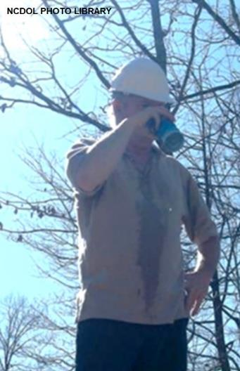
Definitions
1926.32(f)
Competent person
“One who is capable of identifying existing and predictable hazards in the surroundings or working conditions which are unsanitary, hazardous, or dangerous to employees, and who has authorization to take prompt corrective measures to eliminate them.”

Slide 5
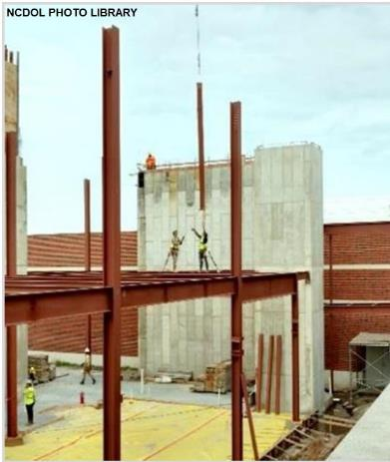
Struck-By Hazards
Struck-by injuries are produced by forcible contact or impact between the injured person and an object or piece of equipment.
Struck-by hazards are categorized as follows:
Struck-by flying object
Struck-by falling object
Struck-by swinging object
Struck-by rolling object

Slide 6
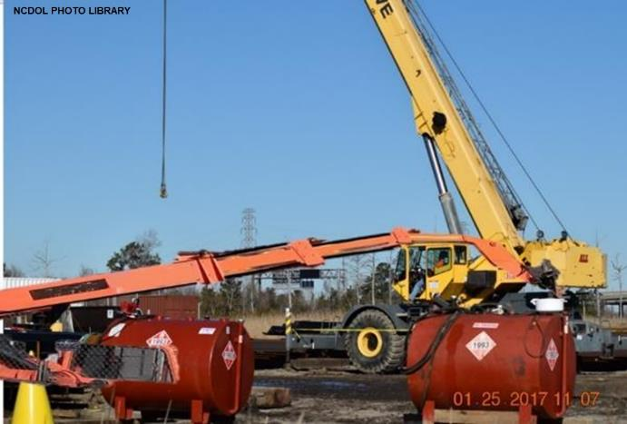
Struck-By Hazards
Struck-by examples:
Tractor trailer, truck or vehicle
A counterweight from piece of equipment
Falling tree, tree-top or limbs/branches
Precast walls
Building materials
Motor graders
Fly wheels
Man-lifts
Forklifts
NCDOL Photo Library

Slide 7
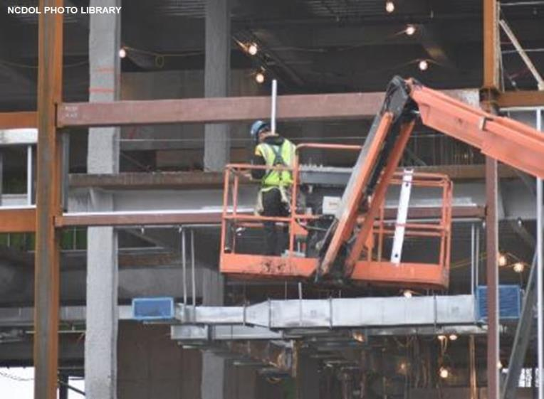
Caught-In or Between Hazards
Hazards causing a person to be squeezed, caught, crushed, pinched, or compressed between two or more objects, or between parts of an object.

Slide 8
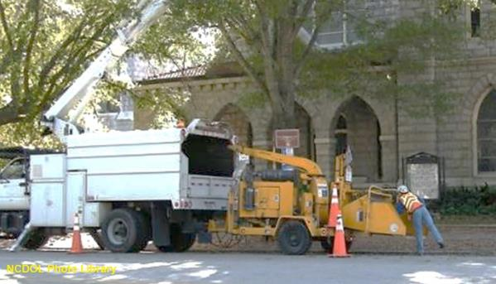
Caught-In or Between Hazards
Caught-in or between examples:
Between a wall and tractor trailer
Caught in/between truck tire and pavement
Caught in/between dock leveler
Caught in woodchipper
NCDOL Photo Library

Slide 9
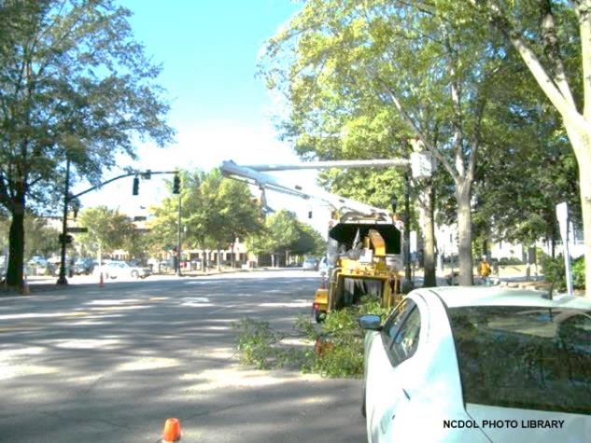
Struck By/Caught Between Causes
Most of these are a direct result of:
Materials handling, storage, use, and disposal
Construction equipment
Motor vehicles
Tools and equipment
Falling trees
Woodchipper

Slide 10
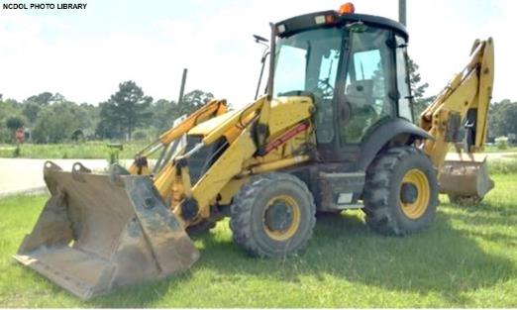
Construction Equipment
Examples of hazards with construction equipment:
Worker crushed by a compactor/roller
Highway construction area/site, when it backed over him
Operator of a backhoe installing sewer lines
Bucket struck an adjacent tree which was rotten, causing the tree to fall, striking another worker in the head that was standing in a 2-foot-deep trench

Slide 11
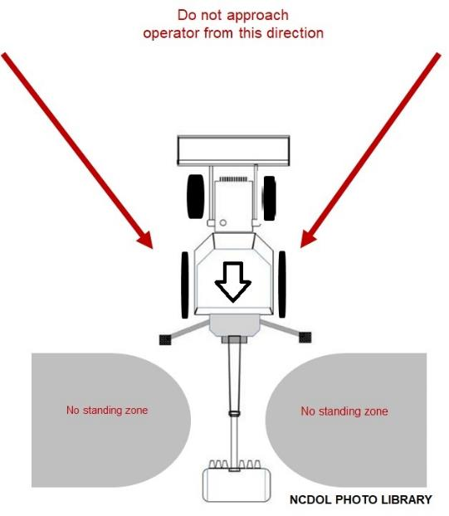
Construction Equipment
No visibility zone:
Backhoe loader
Educate workers how to
approach all construction
equipment while in operation.

Slide 12
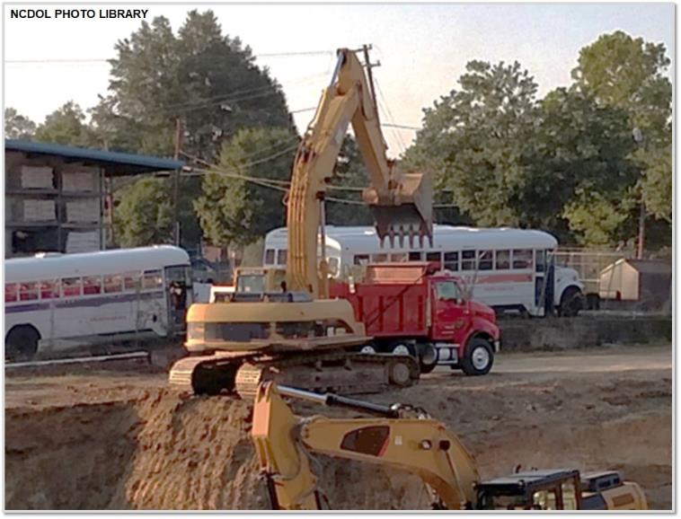
Construction Equipment
Safety issues:
Overhead hazards
Low visibility

Slide 13
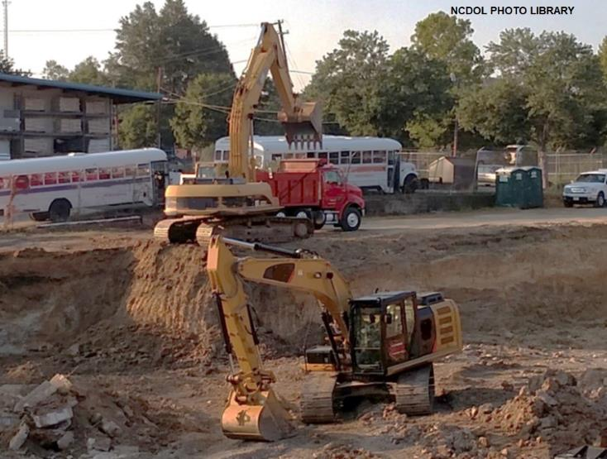
Construction Equipment
Safe work practices:
Roll-over protection structures - “ROPS”
Seatbelts

Slide 14
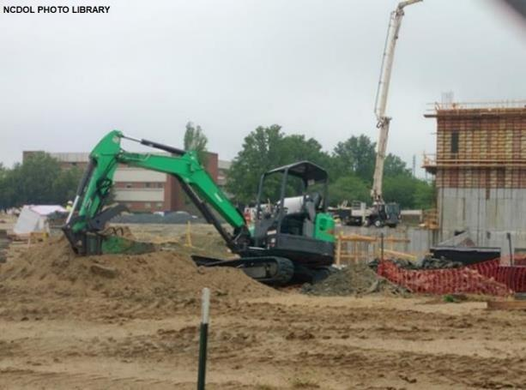
Construction Equipment
1926.602(a)(2)
Rollover protective structures:
Employers are responsible for requiring the wearing of appropriate personal protective equipment.
Failure to use “seat belts” is citable under 1926.28(a).

Slide 15
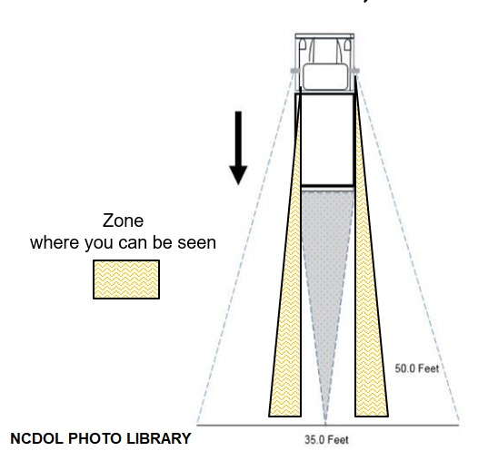
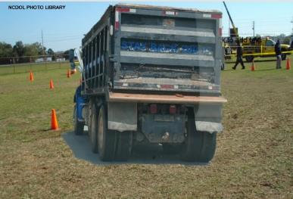
Construction Equipment
No visibility zone:
Do not drive a vehicle in reverse gear with an obstructed rear view, unless it has an audible reverse alarm, or another worker signals that it is safe.

Slide 16
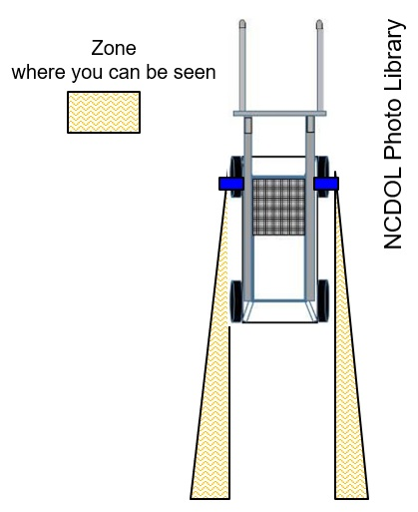
Construction Equipment
No visibility zone:
Do not drive equipment in reverse gear with an obstructed rear view, unless it has an audible reverse alarm, or another worker signals that it is safe.

Slide 17
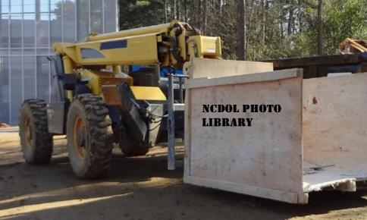
Construction Equipment
Hazard issues:
Workers struck and run over by moving vehicles and equipment.
Workers struck by automobiles while in work zones.
Vehicles/equipment operated in reverse gear with obstructed rear view.
Remember, spotters themselves can be at risk for injury or even death.
NCDOL Photo Library
NCDOL Photo Library

Slide 18
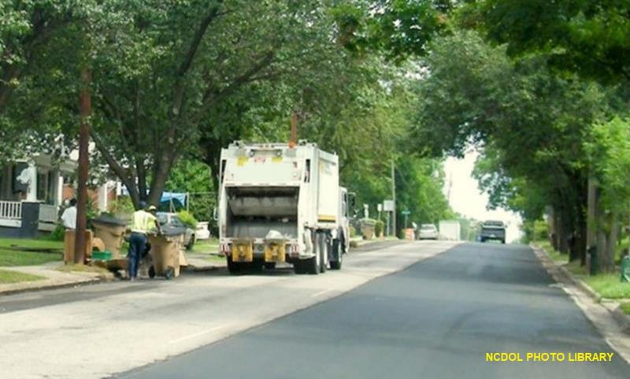
Motor Vehicles
Safe work practices:
When vehicle safety practices are not observed, there is a risk of being struck by oncoming vehicles.
Garbage truck is driving down the wrong side of the street.

Slide 19
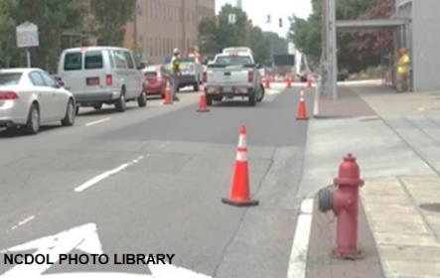
Motor Vehicles
Hazard issues:
Use traffic signs, barricades or flaggers when construction takes place near public roadways.
Workers must be highly visible at all times, day or night.
Safety apparel, such as red or orange vests, are required.
If worn for night work,
must be of reflective
material.
Employee

Slide 20
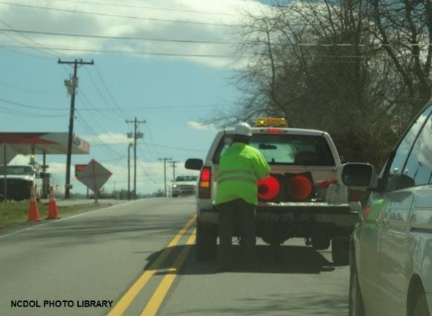
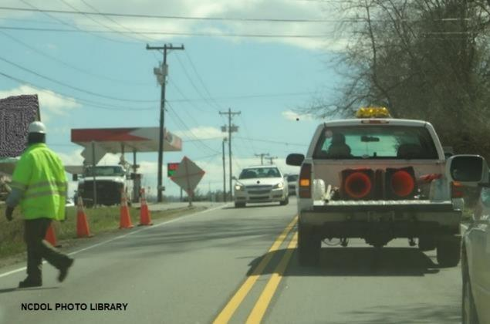
Motor Vehicles
Safe work practices:
When vehicle safety practices are not observed, there is a risk of being struck by vehicles.
NCDOL Photo Library

Slide 21
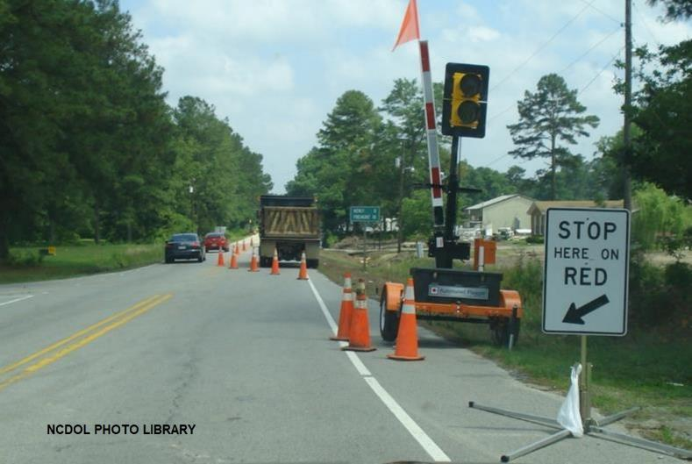
Motor Vehicles
Safe work practices:
Provide an area of separation between traffic flow and work area.

Slide 22
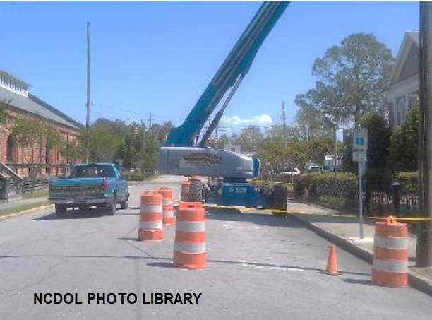
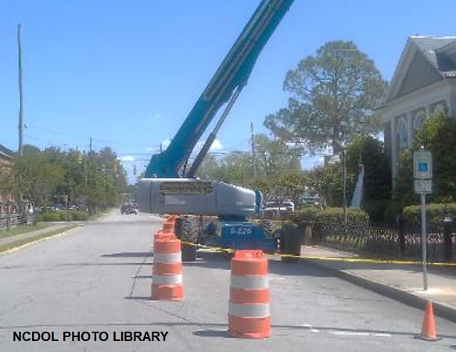
Motor Vehicles
Safe work practices:
Equipment being operated near traffic must be protected by adequate buffer space.
NCDOL Photo Library
NCDOL Photo Library

Slide 23
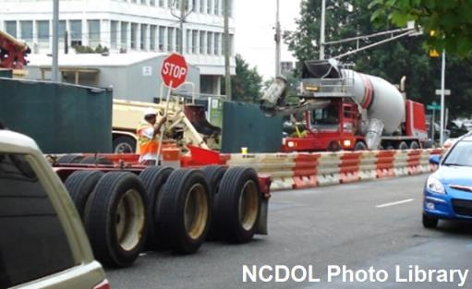
Motor Vehicles
Personal protective equipment:
All workers exposed to the risks of moving roadway traffic or construction equipment should wear high-visibility safety apparel.
NCDOL Photo Library

Slide 24
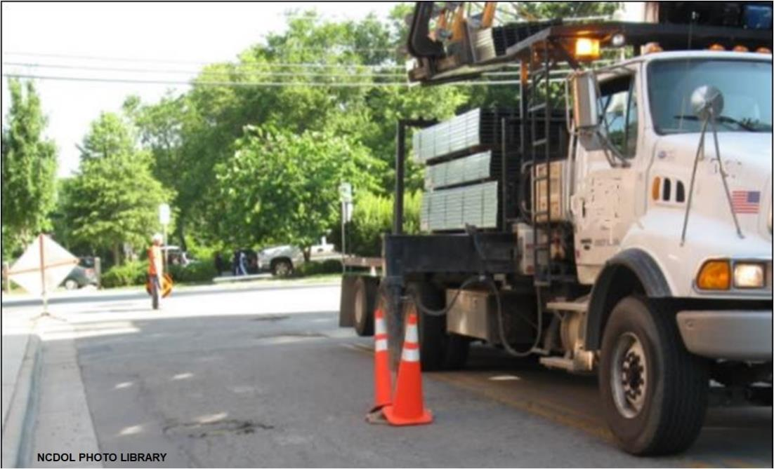
Motor Vehicles
What are the safety issues?

Slide 25
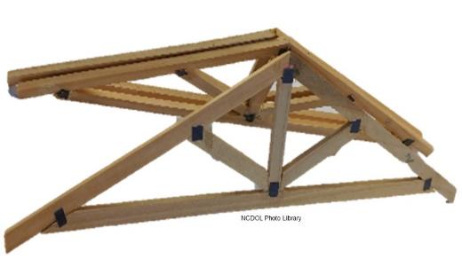
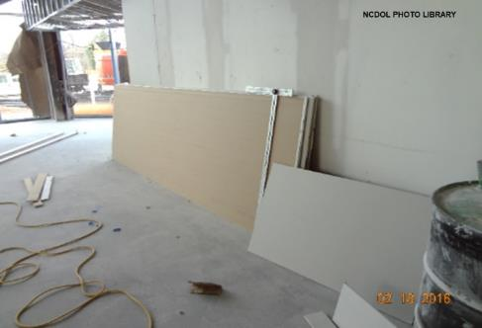
Materials Handling and Storage
Examples:
Worker was standing on the main floor of a one-story single-family residence.
Several trusses collapsed falling onto the worker.
Worker was trying to move a vertically stacked pile of 16 pieces of 12' by 4' drywall.
Drywall shifted pinning him between the stack of drywall and the door jam.

Slide 26
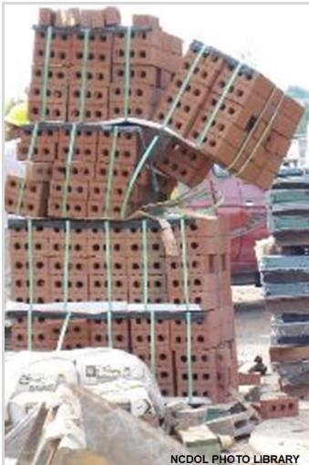
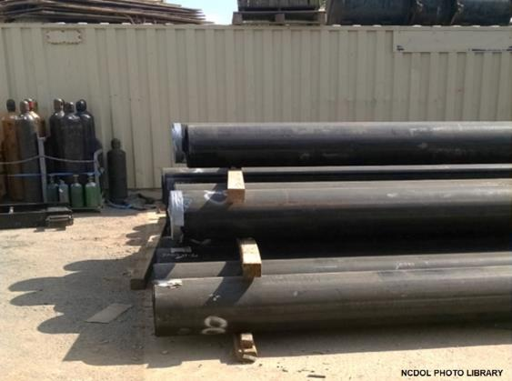
Materials Handling and Storage
Safety issues:
Improperly stored materials
Incorrectly cutting ties or other securing devices
Improper loading and unloading

Slide 27
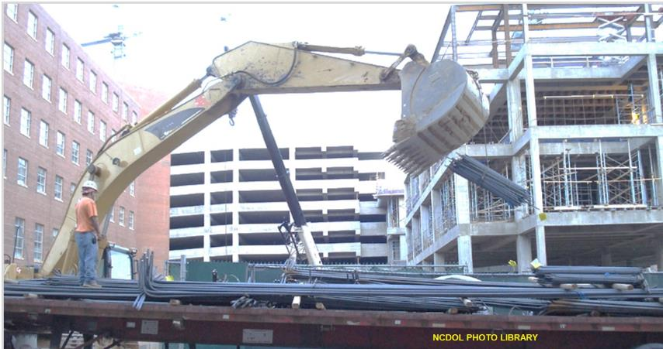
Materials Handling and Storage
Safety issues:
Improperly stored materials
Incorrectly cutting ties or other securing devices
Improper loading and unloading

Slide 28
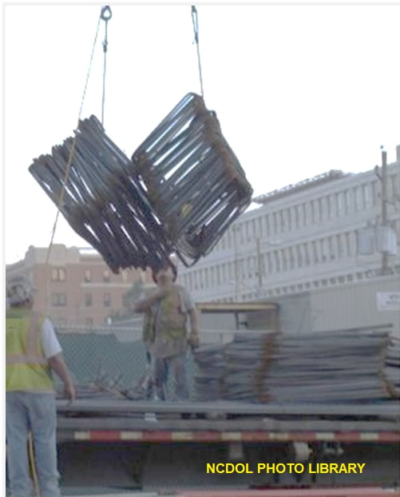
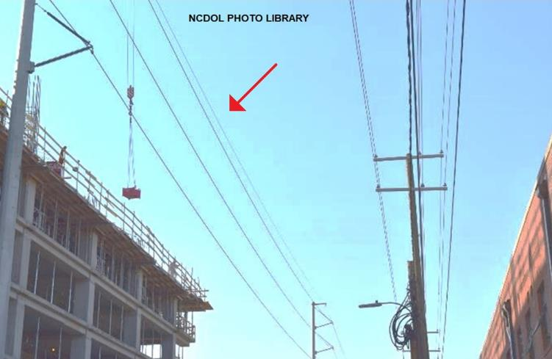
Materials Handling and Storage
What safety issues do you see?
Electrical safety
Falling object protection

Slide 29
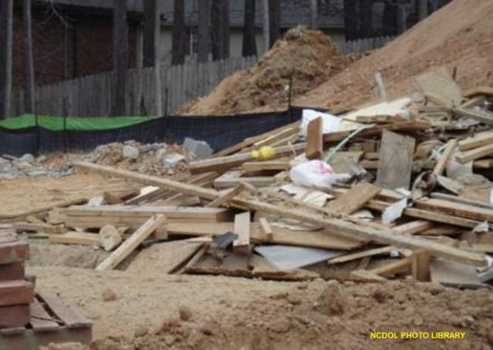
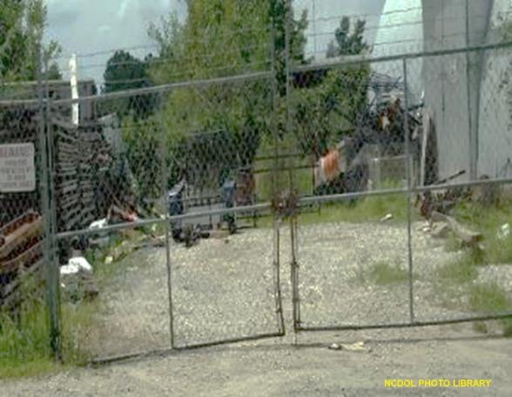
Materials Handling and Storage
What are the safety issues?
Housekeeping

Slide 30
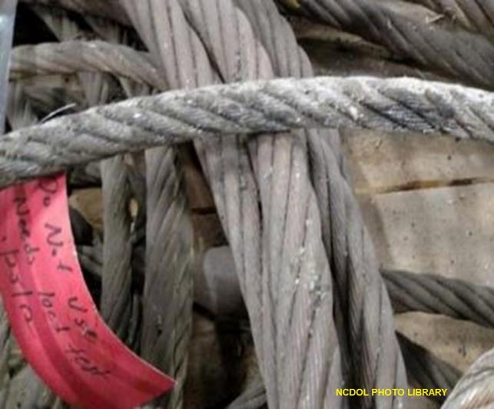
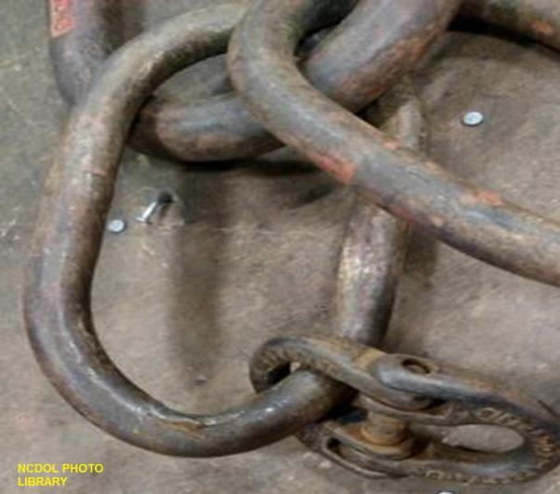
Materials Handling and Storage
Rigging safety issues:
Using defective rigging equipment
Excessive loading

Slide 31
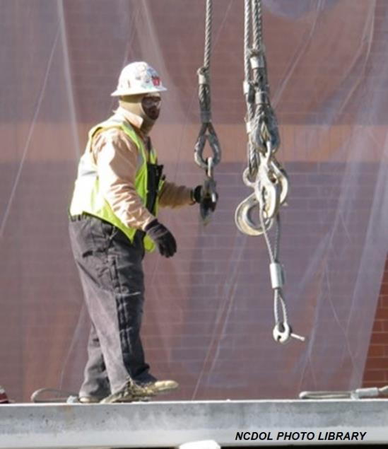
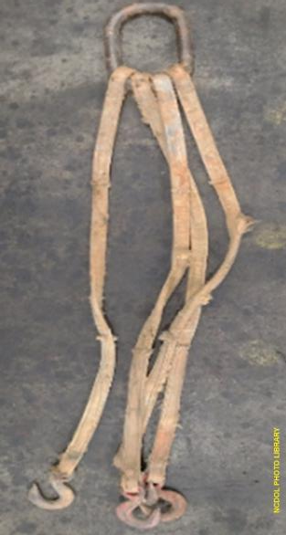
Materials Handling and Storage
What are the rigging safety issues?
Qualified rigger

Slide 32
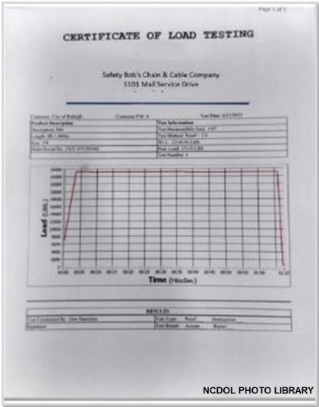
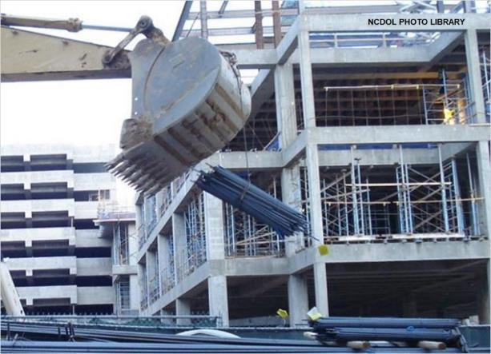
Materials Handling and Storage
Rigging safe work practices:
Load should not exceed rated capacity
Protect sling from sharp corners
Know center of gravity of load

Slide 33
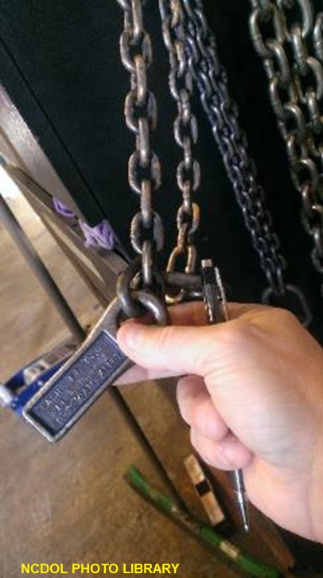
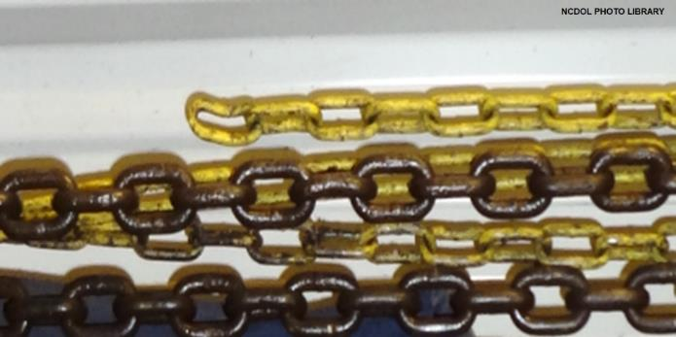
Materials Handling and Storage
Rigging safe work practices:
Inspect the rigging
Keep personnel clear
Never leave load unattended
Wear hardhats when lifting

Slide 34
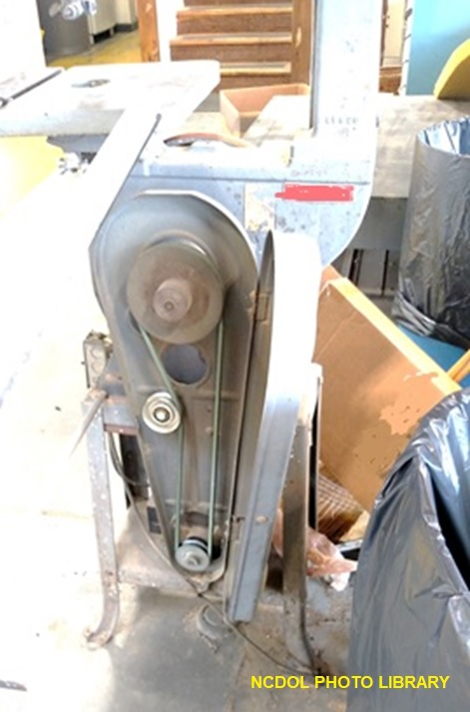
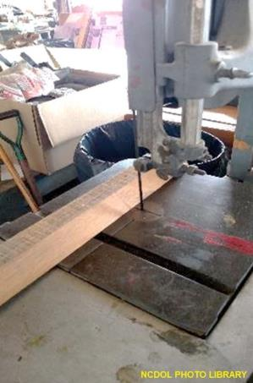
Tools and Equipment
Safety issues:
Improper work procedures
Machine guards
Use of defective equipment

Slide 35
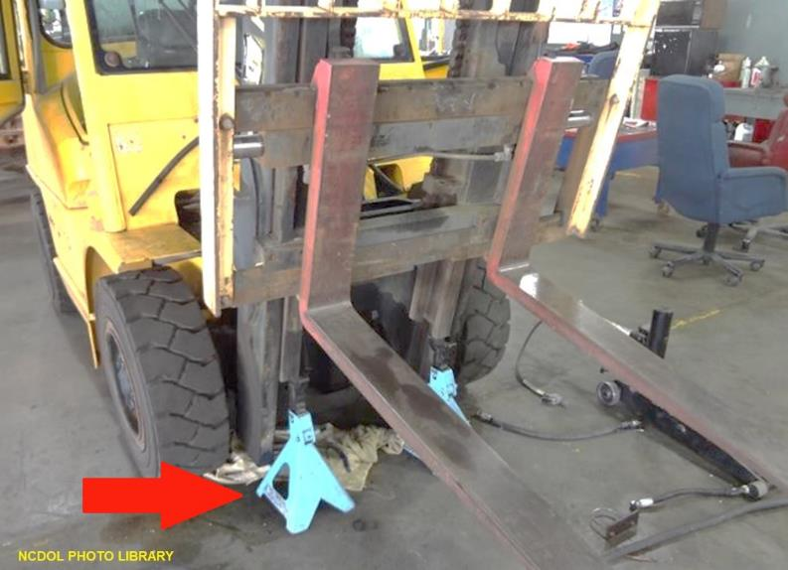
Tools and Equipment
Are there safety issues?
Jacks must have a rated capacity
1926.303(a)(1) and 1926.305(d)(1)(i)

Slide 36
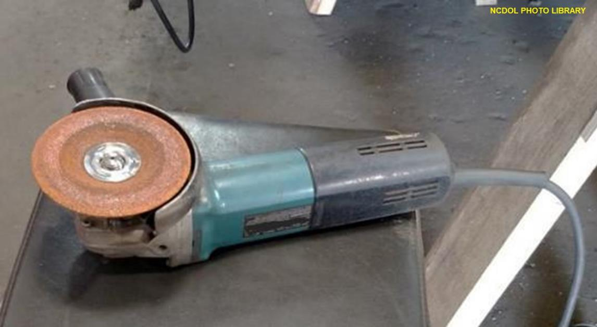
Tools and Equipment
1926.303(c)(6)
Are there safety issues?

Slide 37
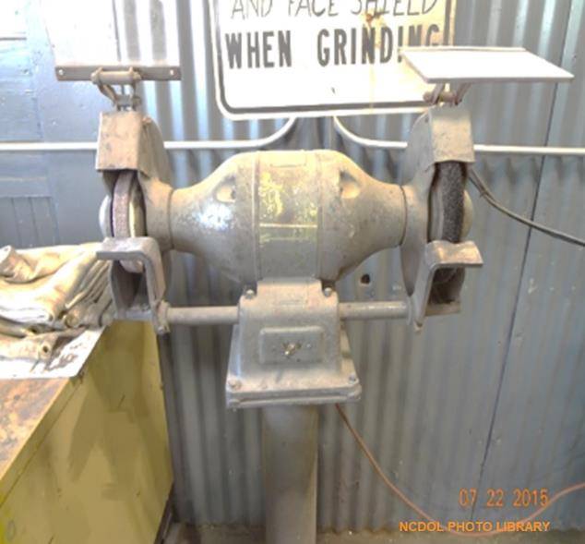
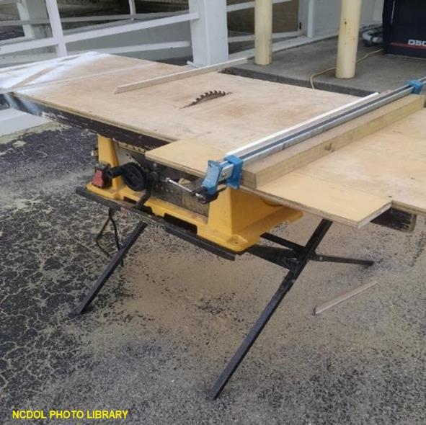
Tools and Equipment
What are the safety issues?

Slide 38
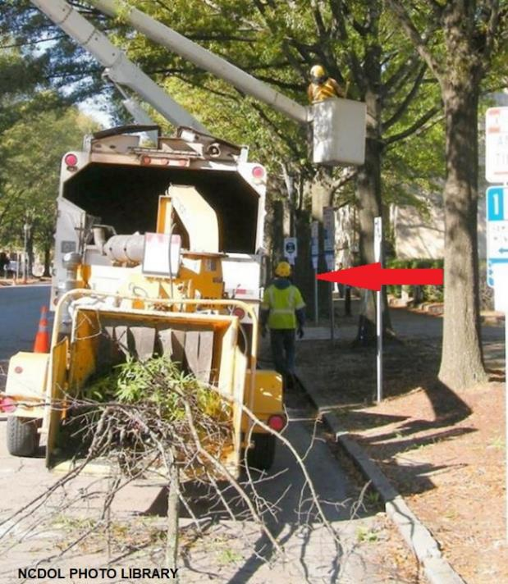
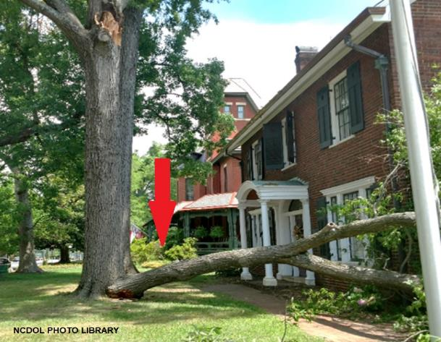
Falling Trees
What are the hazards?
Trees
Falling branches

Slide 39
Woodchippers
What are the hazards?
NCDOL Photo Library

Slide 40
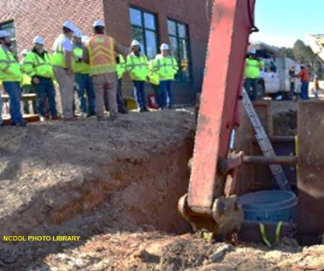
Preventing Struck By/Caught Between Injuries
Comprehensive Safety Program
Development, implementation, and enforcement of program for workers
Includes training in the recognition and avoidance of unsafe work conditions and instruction in safe work practices
If a multilingual workforce, instruction should be in the language understood by the worker
Ensures appropriate PPE and usage

Slide 41
Summary
In this course, we covered:
Recognizing potential struck-by/caught-in or between situations
Identifying struck-by/caught-in or between hazards
Evaluating control measures for struck-by/caught-in or between hazards
NCDOL Photo Library

Slide 42
Thank You For Attending!
Final Questions?

